Slide 1

Database system
Theoretical lectures
The Sixth lecture
Assistant teacher Shaymaa Abdulkarem

Slide 2
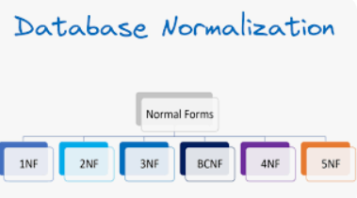
Types of Normalization:
There are types of normalization
1.First Normal Form (1NF)
2. Second Normal Form(2NF)
3.Third Normal Form (3NF)

Slide 3
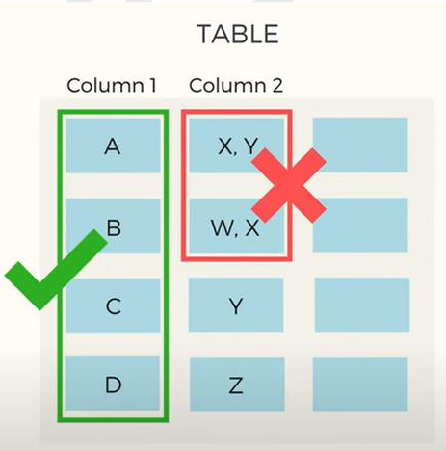
Types of Normalization
There are four basic rules that a tables should follow to be in the first normal form.
Rule 1 :
Each column should contain atomic values.
For example:
Entries like X,Y and W,X
violate this rule.
“Each attribute must contain only a single
value from its pre-defined domain”

Slide 4
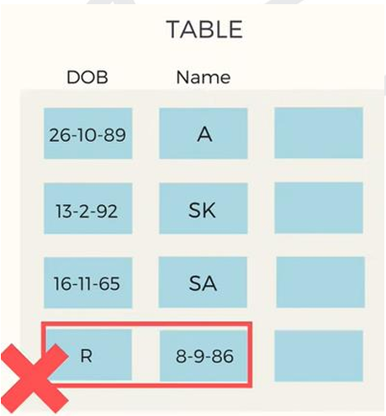
Types of Normalization
Rule 2 :
– A column should contain values that are of the same type.
For example:
Entries like R in DOB and 8-9-86
violate this rule.
“don’t inter-mix different types of values in any column.”

Slide 5
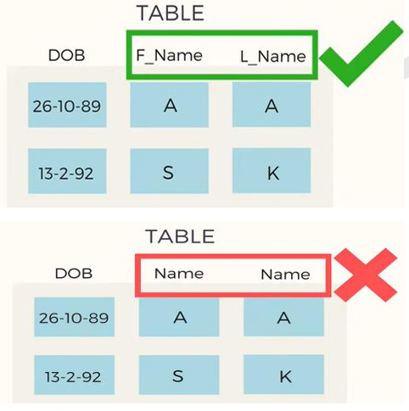
Types of Normalization
Rule 3 :
– Each column should have a unique name.
For example:
F_name and L_name different name.
“same name leads to confusion at the time of data retravel.”

Slide 6
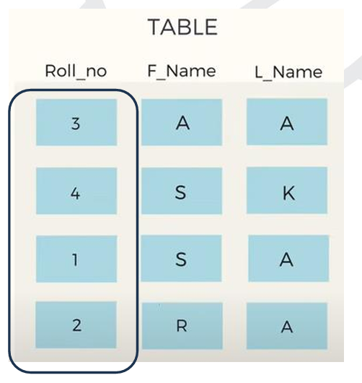
Types of Normalization
Rule 4 :
– Order in which data is saved doesn’t matter.
For example:
3, 4, 1 and 2are not order in Roll_no
“using SQL query, you can easily fetch data in any order from a table.”

Slide 7
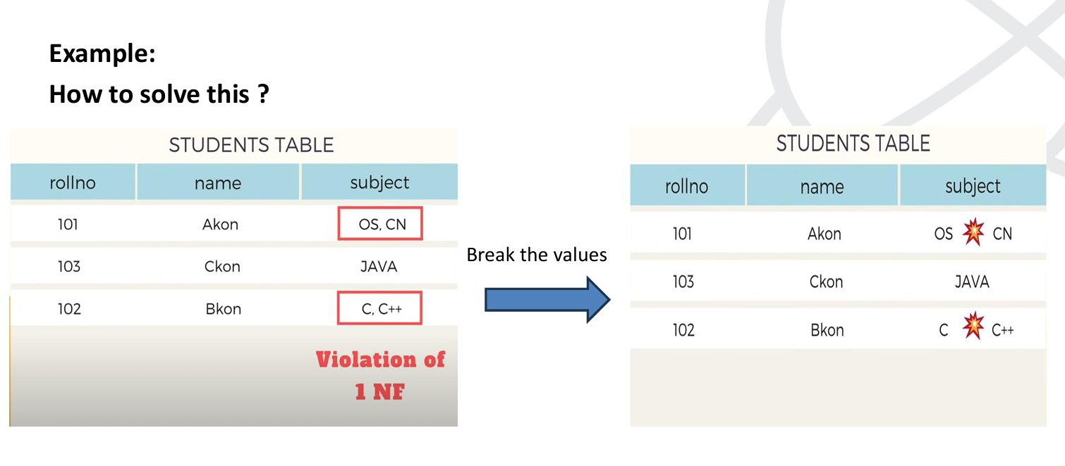
Types of Normalization

Slide 8
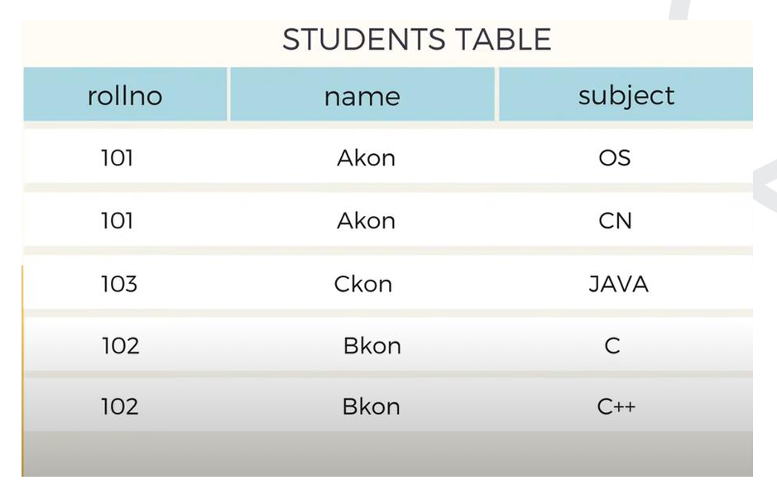
Types of Normalization

Slide 9
Types of Normalization
2. Second Normal
Form For a table a table to be in the second normal form there are two conditions:
it should be in the first normal form
it should not have any partial dependencies
Prime attribute −An attribute, which is a part of the prime-key, is known as a prime attribute.
Non-prime attribute − An attribute, which is not a part of the prime-key, is said to be a non prime attribute.

Slide 10
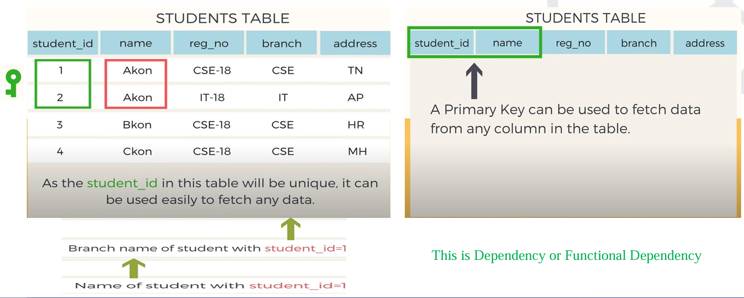
Example
Dependency is ?

Slide 11
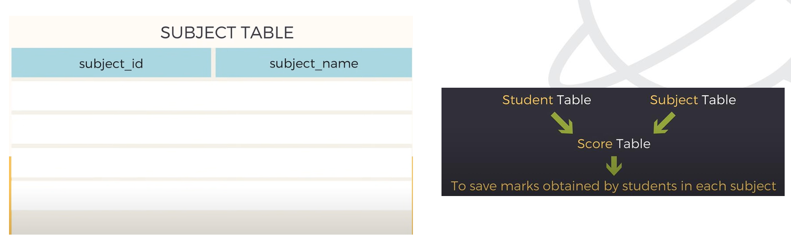
Example
Partial Dependency is ?

Slide 12
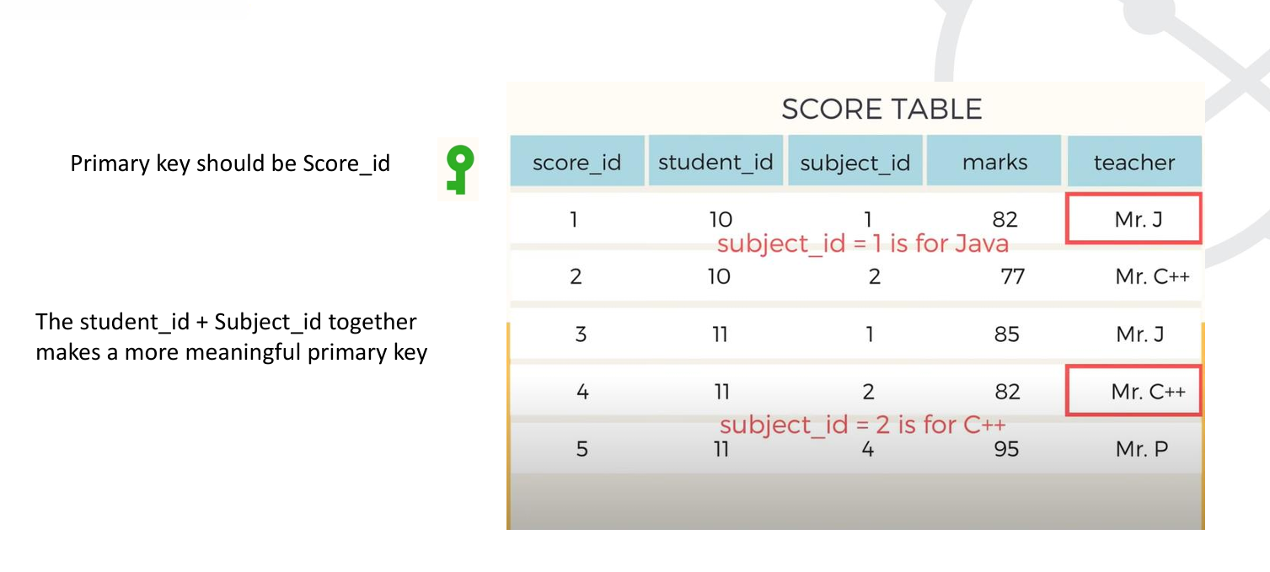
Example

Slide 13
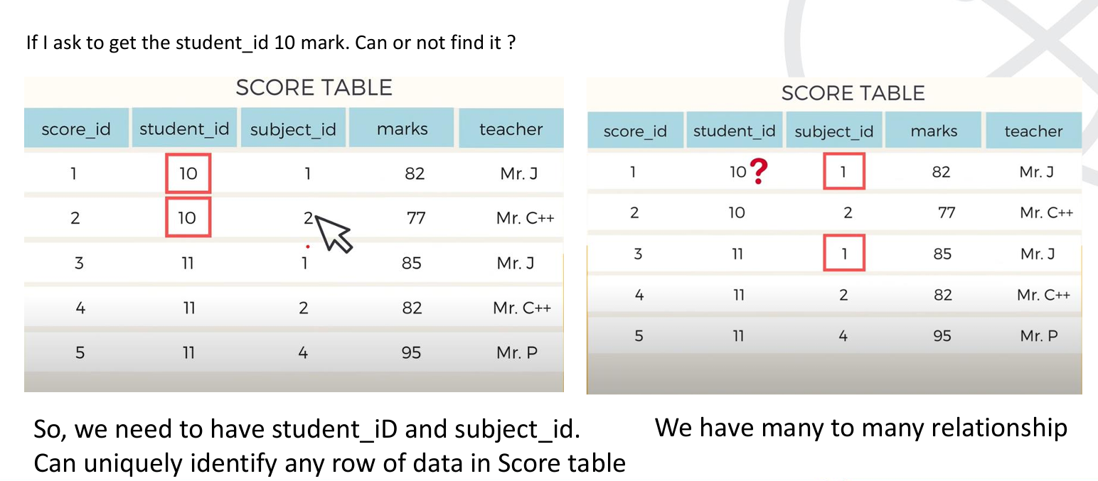
Example

Slide 14
Types of Normalization
Many to many relationship means
One Student can opt for more than one Subject
&
One Subject can be opted by more than one Student

Slide 15
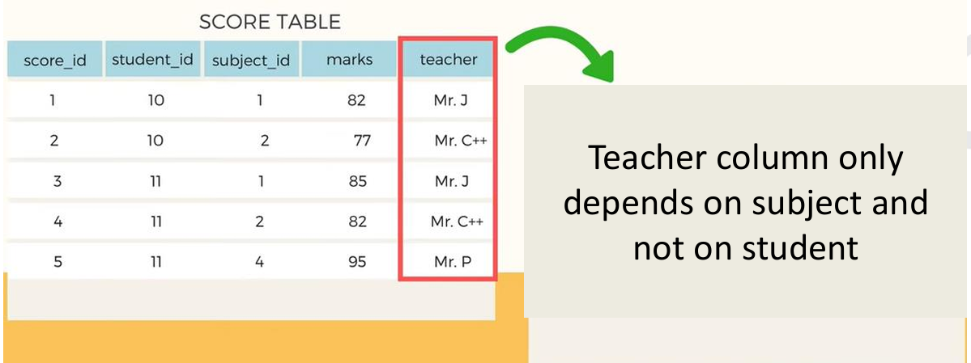
Example
This is partial dependency

Slide 16
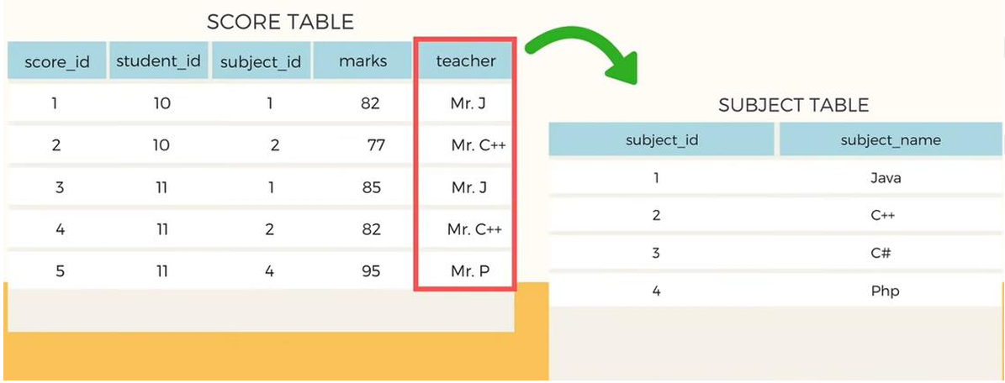
Example
How to remove the partial dependency ? Our objective is to remove teacher column from score table

Slide 17
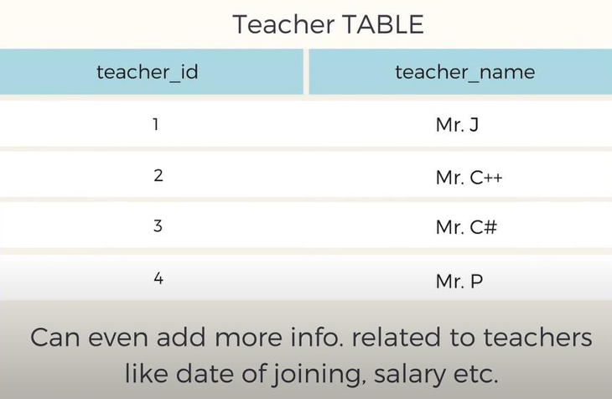
Example
How to remove the partial dependency ? Our objective is to remove teacher column from score table

Slide 18
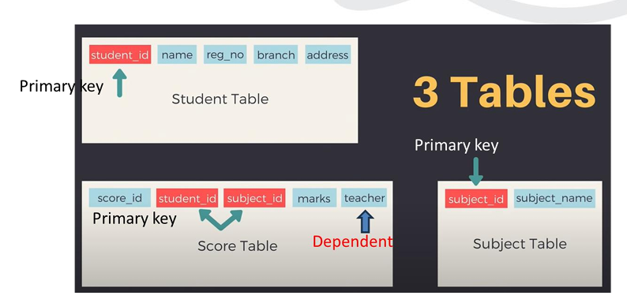
Types of Normalization
3. Third Normal
Form For a relation to be in Third Normal Form,
It must be in Second Normal form and the following must satisfy
It should not have trans

Slide 19
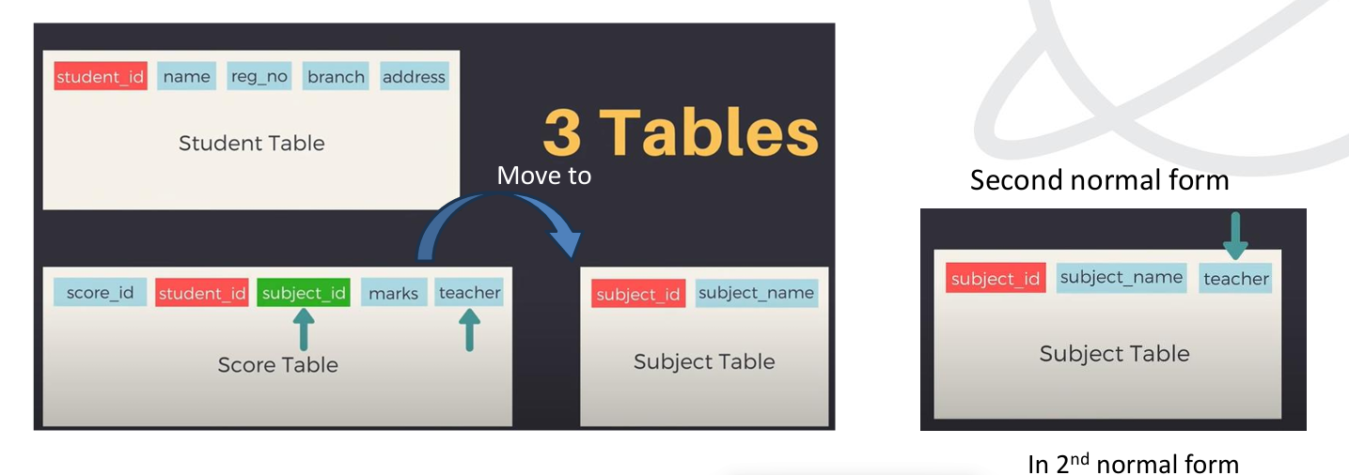
Types of Normalization

Slide 20
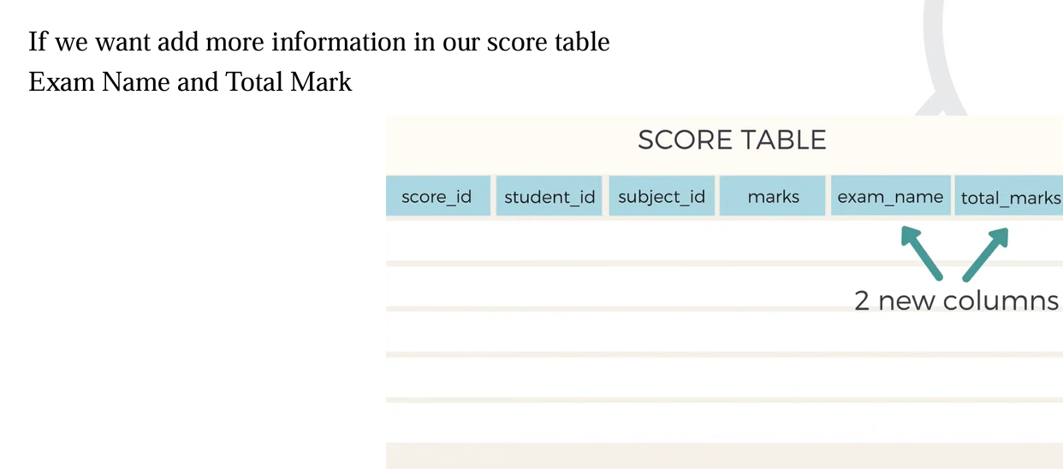
Types of Normalization

Slide 21
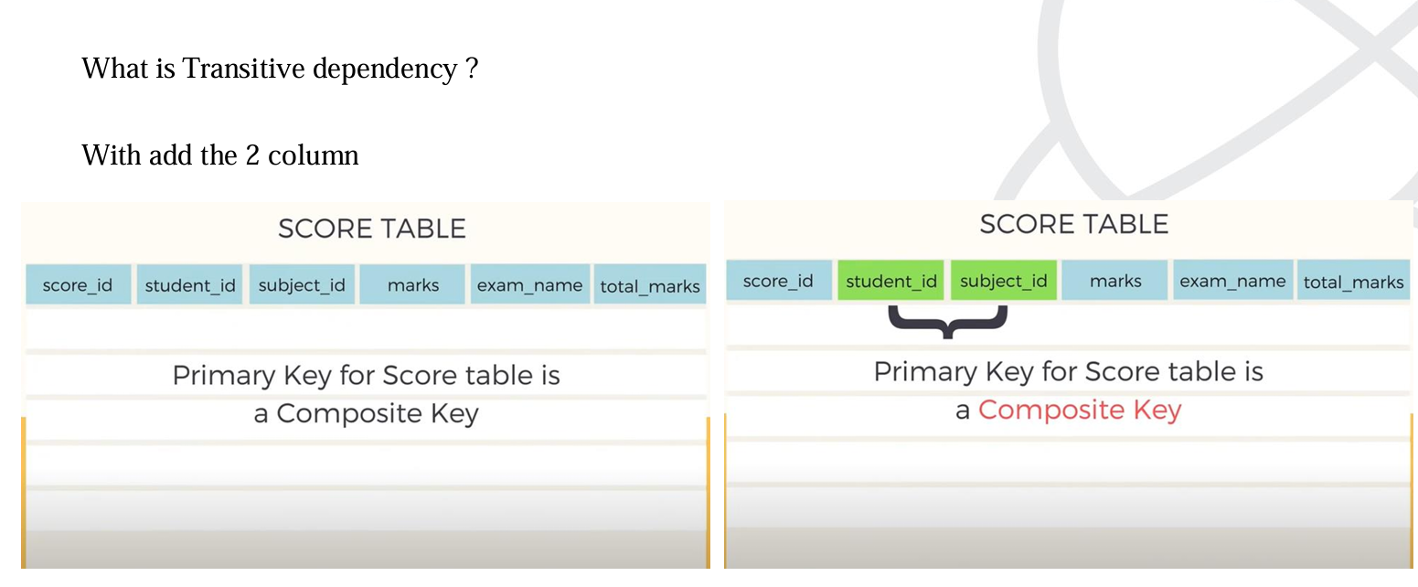
Types of Normalization
What is Transitive dependency ?
With add the 2 column

Slide 22

Types of Normalization
Example

Slide 23
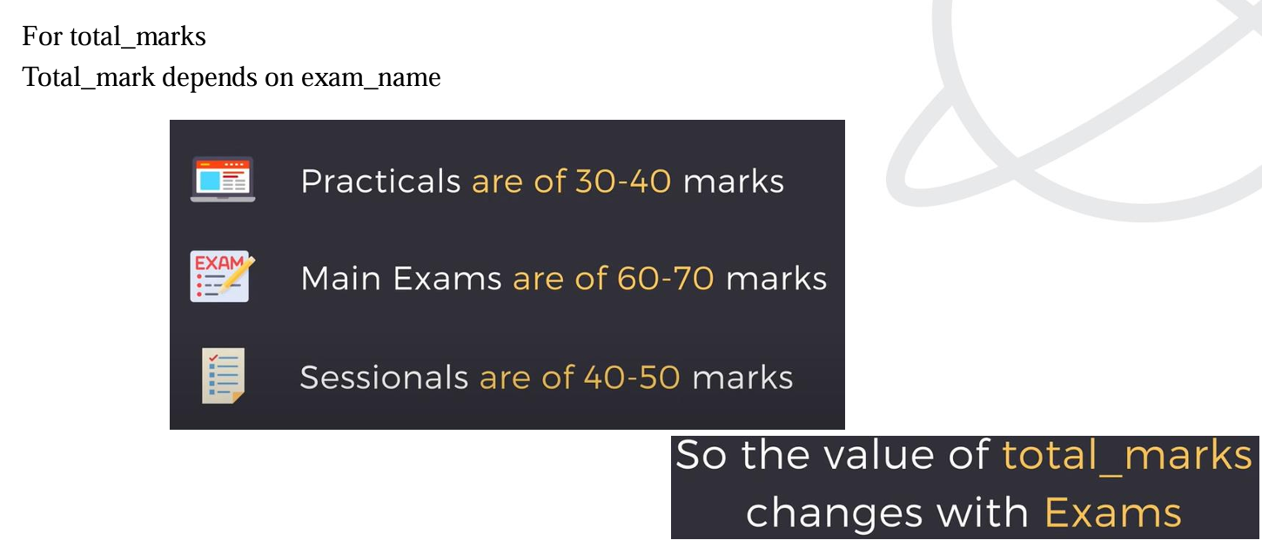
Types of Normalization
For total_marks
Total_mark depends on exam_name

Slide 24
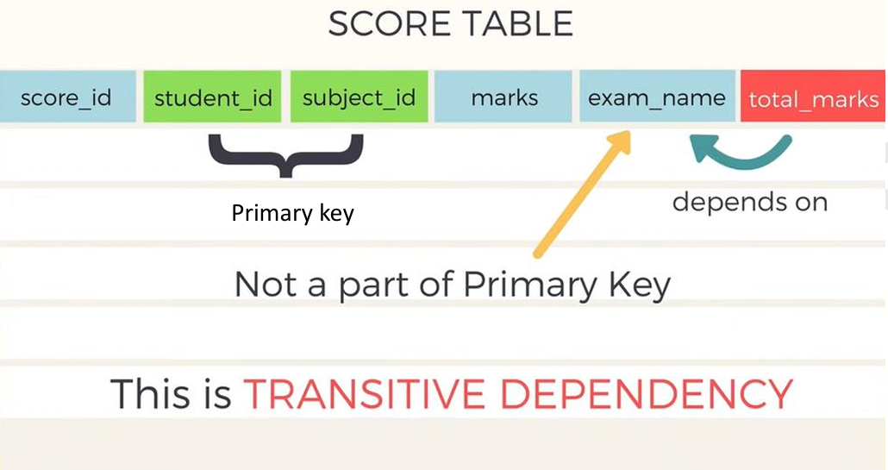
Types of Normalization

Slide 25
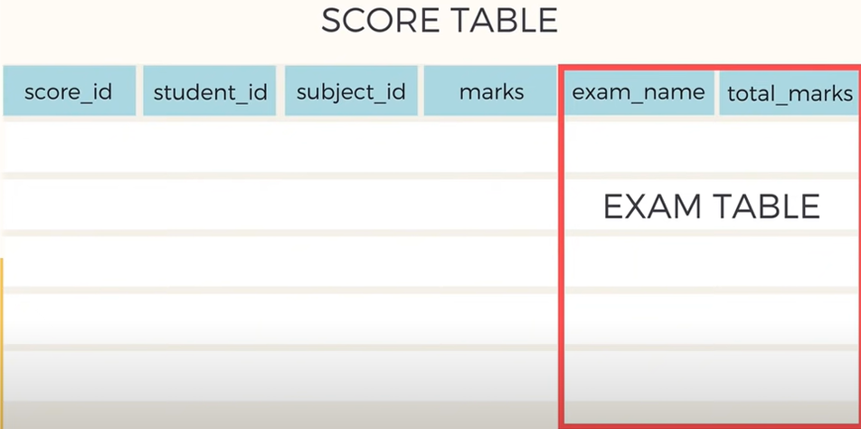
Types of Normalization
The solution to this problem is

Slide 26
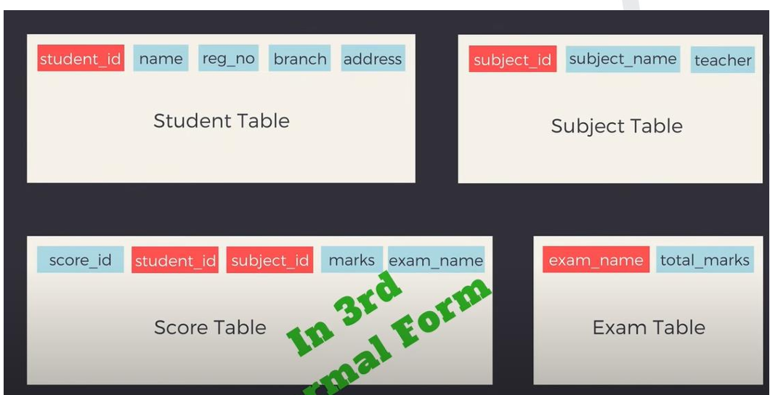
Types of Normalization

