Slide 1

Compensation
AL-Ma'moon University College
Computer Engineering Techniques
Third Stage
Of Control System
2024-2025

Slide 2
Outline
Definition Of Compensation
Structure Of Compensation
Types Of Compensation
Passive Compensation Controller
Active Compensation Controller

Slide 3
Definition Of Compensation
Increasing an component, which makes the systems’ performance to be improved, other than only varying the systems’ parameters, this procedure is called Compensation
Compensator: The compensator is an additional component or circuit that is inserted into the control system to compensate for a deficient performance.

Slide 4
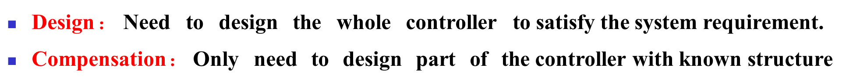
Three elements for compensation
Control system
Design and Compensation
Original part of system
Performance Requirement
Compensation device

Slide 5


Structure Of Compensator
According to the way of compensation, the compensator can be classified into following categories:
Cascade Compensation
R(s) ₊
C(s)
Compensator
Plant
-
(a) Cascade Compensation

Slide 6


Feedback compensation
+
+
Original Part
C(s)
-
-
Compensator
(b) Feedback compensation

Slide 7


Cascade and feedback compensation
R(s)
+
Compensator
1
+
Original Part
C(s)
-
-
Compensator
2
(c)Cascade and feedback compensation

Slide 8


Disturbance compensation
Compensator
N(s)
+
+
C(s)
R(s) ⁺
Controller
+
Original Part
+
-
(e) Disturbance compensation

Slide 9

Remark：
Cascade compensation and feedback compensation are inside the feedback loop.
Feed-forward compensation and disturbance compensation are outside the feedback loop.

Slide 10
Compensator Types
Passive Compensation Controller
Lead Comp.
Lag Comp.
Active Compensation Controller
P Controller
Lead-Lag Comp.
PI
PD
PID
P: proportional I: Integral D: Differential

Slide 11
Types Of Passive Compensation Controller
Phase-Lead Controller
Phase-Lag Controller
Phase Lead-Lag Controller

Slide 12
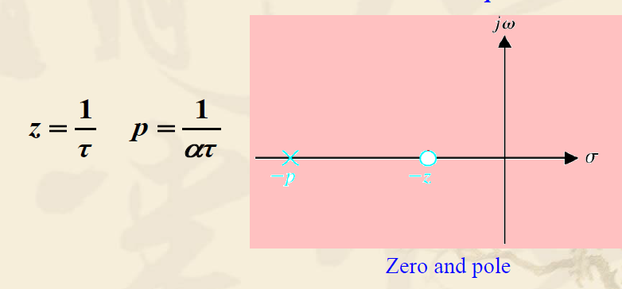
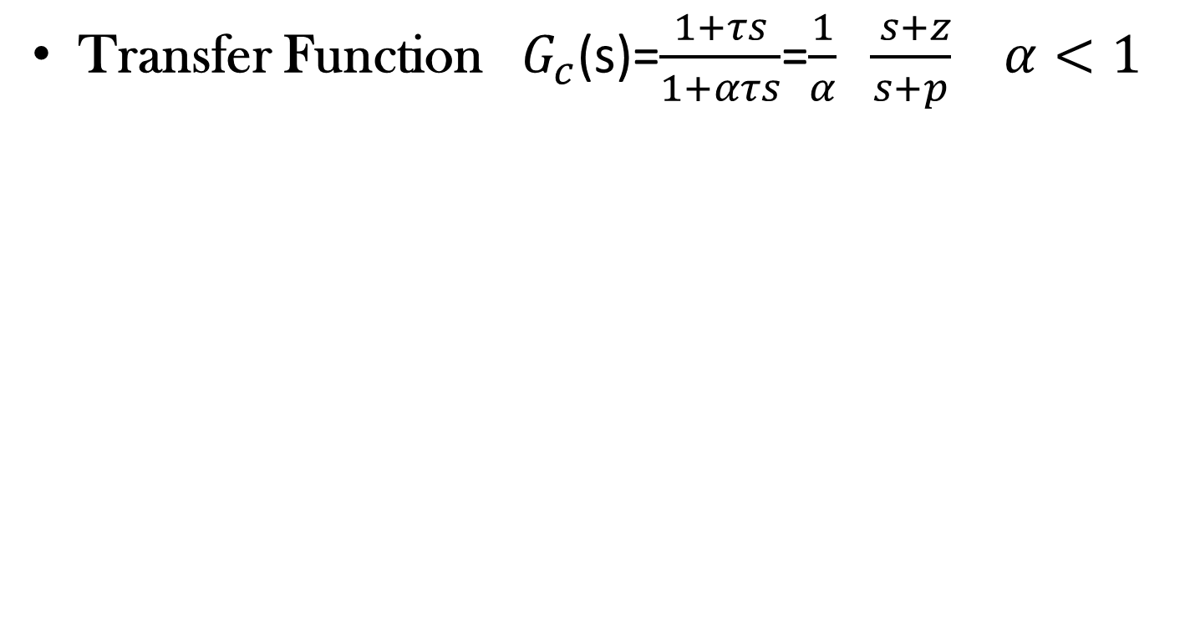
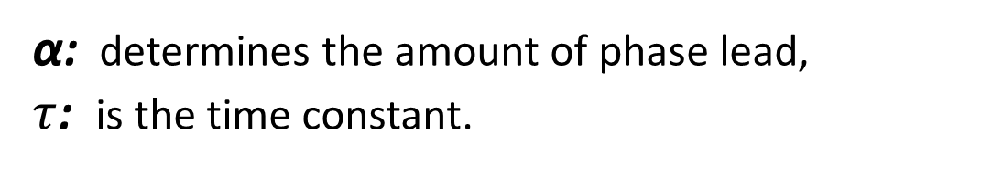
Phase Lead Controller
Transfer Function $G_{c}$(s)=$\frac{1+τs}{1+ατs}$=$\frac{1}{α} \frac{ s+z}{s+p}$ $α<1$
α: determines the amount of phase lead,
$τ$: is the time constant.

Slide 13
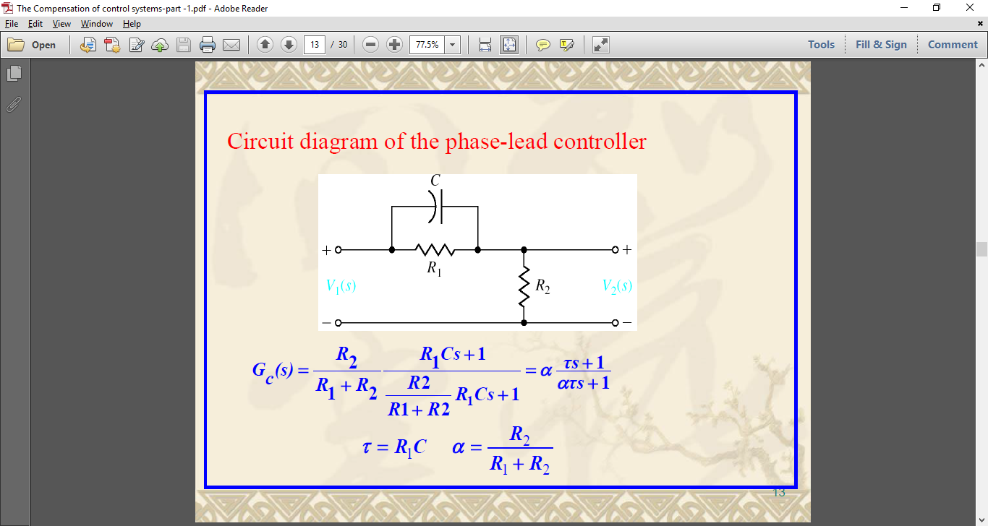


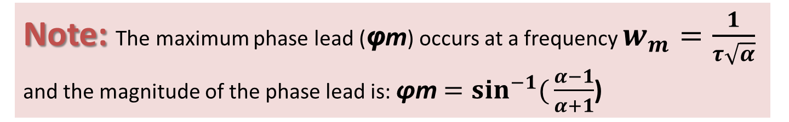
Circuit Diagram of Phase-Lead Controller
2 α
20 logα
20dB / dec
1
α$τ$
m
$$τ$$
Note: The maximum phase lead (φm​) occurs at a frequency $w_{m}=\frac{1}{τ\sqrt{α}}$​ and the magnitude of the phase lead is: ϕm $=\sin^{−1}({\frac{α−1}{α+1}}$)

Slide 14



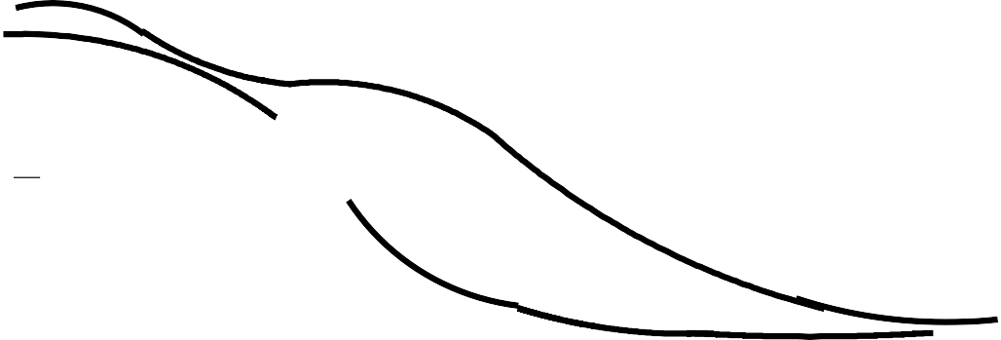



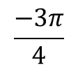
Effect of Phase-Lead Compensation
L(ω), ϕ(ω)
[−20]
40
20
0
[−20]
[− 40]
1000
ω
10
23.8
142
[− 40]
100
[− 40]
2
1
$$\frac{−π}{2}$$
ω
$$\frac{−3π}{4}$$
1
2
−π

Slide 15
Effect of Phase-Lead Compensation
Increases Phase Margin
Improve the Transient Response
Reduction in rise time of closed loop system
Increases Bandwidth
Enhances Stability

Slide 16
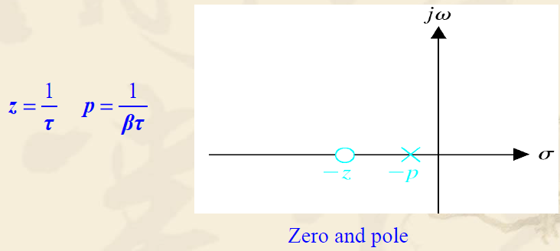
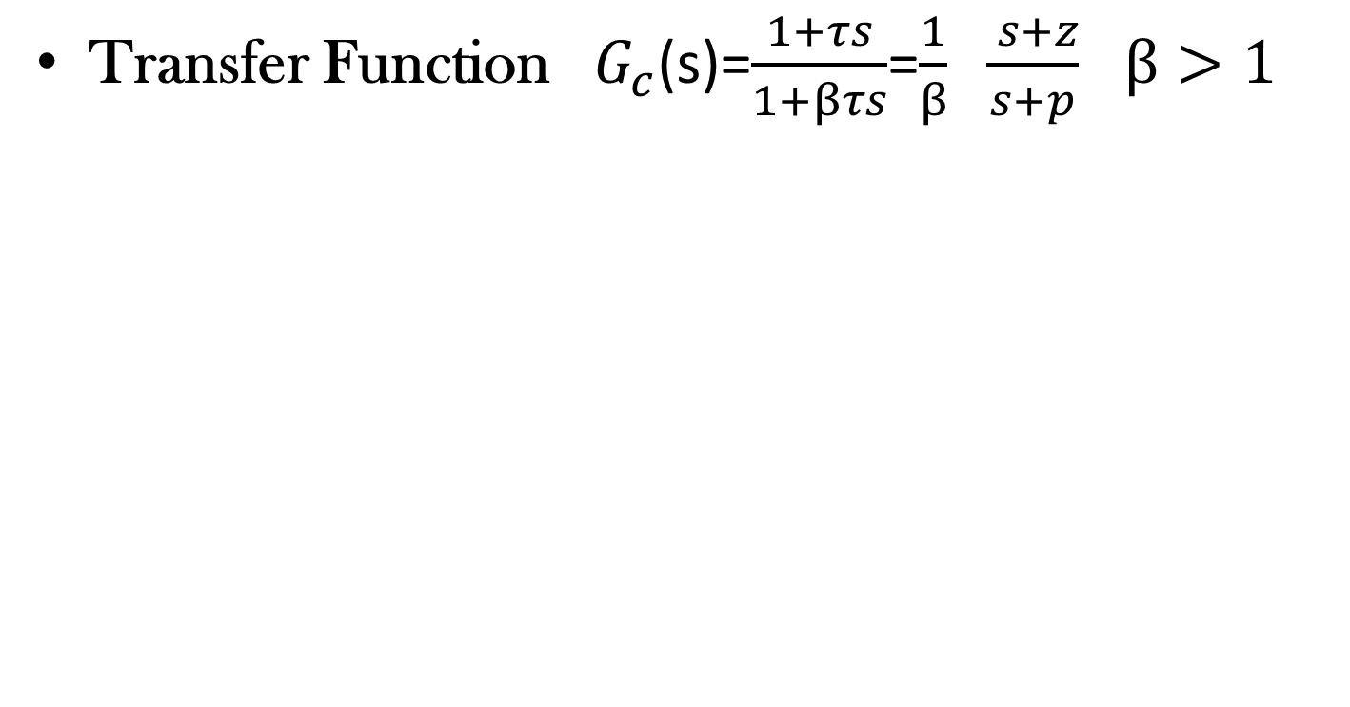
Phase Lag Controller
Transfer Function $G_{c}$(s)=$\frac{1+τs}{1+βτs}$=$\frac{1}{β} \frac{ s+z}{s+p}$ $β>1$

Slide 17


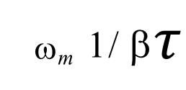

Circuit Diagram of Phase-Lag Controller
R₁
R₂
L(ω )
− 20dB/ dec
E_{i}
E
ω
o
10 lg β
Maximum phase lag
20 lg β
ϕ (ω )
ω_{m} 1/ β$τ$
ϕm $=\sin^{−1}({\frac{β−1}{β+1}}$)
1 /$τ$
ω
−ϕ _{m}

Slide 18
Effect of Phase-Lag Compensation
Reduces Steady-State Error
Improves Steady-State Performance
Decreases Bandwidth

Slide 19
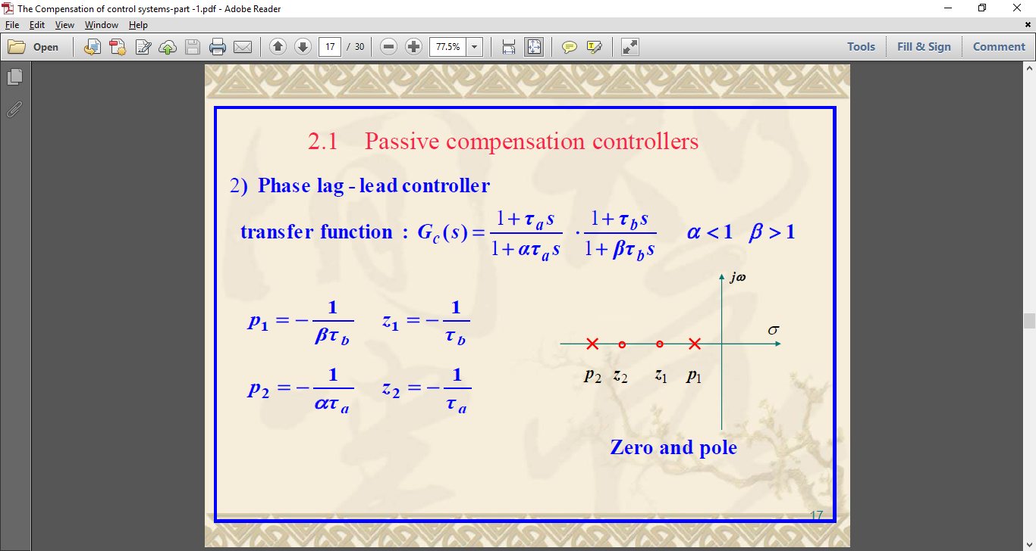
Phase Lead- Lag Controller

Slide 20
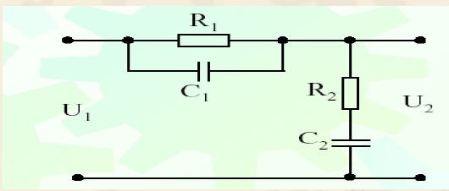
Circuit Diagram of Phase Lead-Lag Controller

Slide 21
Effect of Phase Lead -Lag Compensation
Improves Transient Response (Lead Part)
Reduces Steady-State Error (Lag Part)
Balances Stability and Accuracy

Slide 22

  CHOSE THE SUITABLE ANSWER WITH EXPLINATION
Q1: A phase lead compensation leads to:
Increase in overshoot
Reduction in bandwidth of closed loop system
Reduction in rise time of closed loop system
Reduction in gain margin

Slide 23
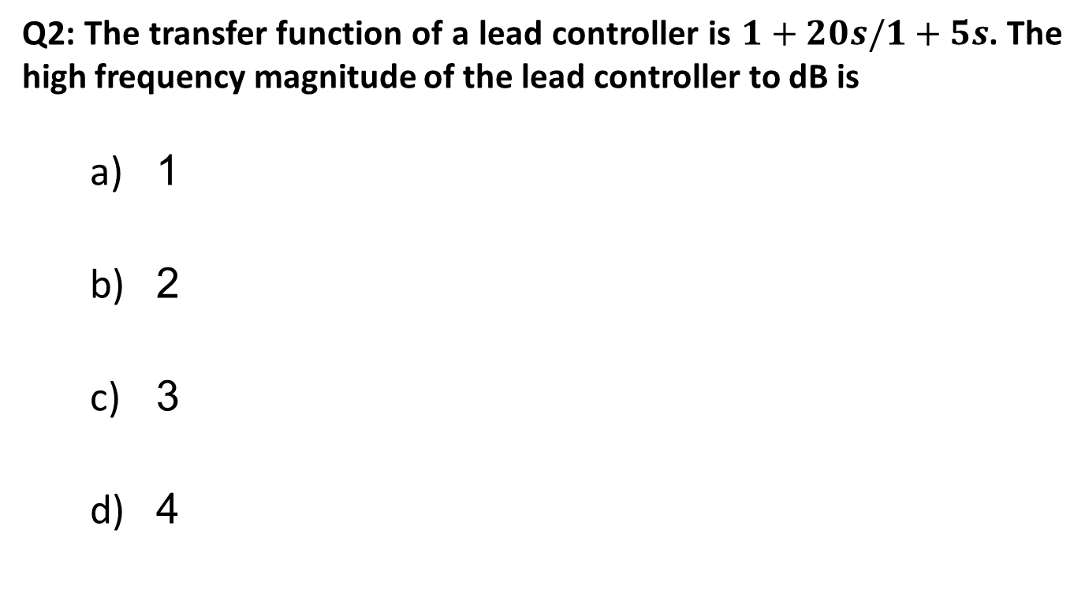
  CHOSE THE SUITABLE ANSWER WITH EXPLINATION
Q2: The transfer function of a lead controller is $1+20s/1+5s$. The high frequency magnitude of the lead controller to dB is
1
2
3
4

Slide 24
  CHOSE THE SUITABLE ANSWER WITH EXPLINATION
Q3: Controllers play the following role in control system:
They amplify the signals going to the actuator
They act on the error signal coming out of the summing junction and output a suitable to the actuator
They try to reduce steady state error optimizes overshoot.
All of the mentioned

Slide 25
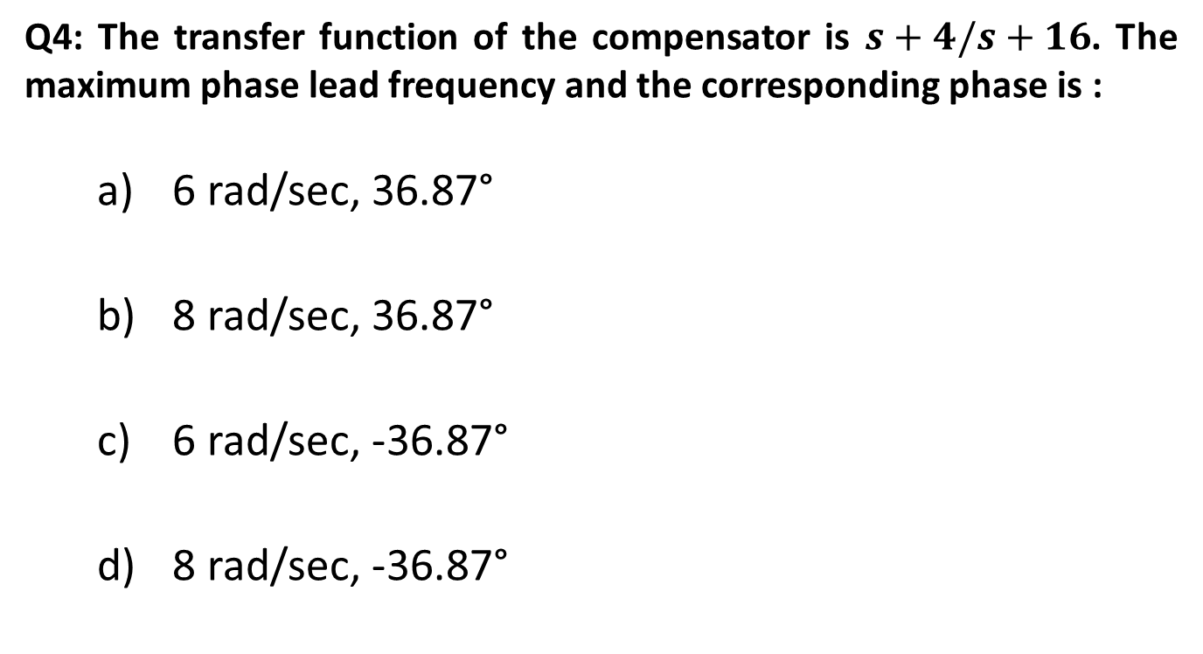
  CHOSE THE SUITABLE ANSWER WITH EXPLINATION
Q4: The transfer function of the compensator is $s+4/s+16$. The maximum phase lead frequency and the corresponding phase is :
6 rad/sec, 36.87°
8 rad/sec, 36.87°
6 rad/sec, -36.87°
8 rad/sec, -36.87°

Slide 26
  CHOSE THE SUITABLE ANSWER WITH EXPLINATION
Q5: The input of a controller is
Sensed signal
Error signal
Desired variable value
Signal of fixed amplitude not dependent on desired variable value

Slide 27
  CHOSE THE SUITABLE ANSWER WITH EXPLINATION
Q6: Phase lag controller:
a) Improvement in transient response
b) Reduction in steady state error
c) Reduction is settling time
d) Increase in damping constant

Slide 28
  CHOSE THE SUITABLE ANSWER WITH EXPLINATION
Q7: Addition of zero at origin:
a) Improvement in transient response
b) Reduction in steady state error
c) Reduction is settling time
d) Increase in damping constant

Slide 29
  CHOSE THE SUITABLE ANSWER WITH EXPLINATION
Q8: Lag compensation leads to:
a) Increases bandwidth
b) Attenuation
c) Increases damping factor
d) Second order

Slide 30
  CHOSE THE SUITABLE ANSWER WITH EXPLINATION
Q9: Lead compensation leads to:
a) Increases bandwidth
b) Attenuation
c) Increases damping factor
d) Second order

Slide 31
  CHOSE THE SUITABLE ANSWER WITH EXPLINATION
Q10: Lag- Lead compensation leads to:
a) Increases bandwidth
b) Attenuation
c) Increases damping factor
d) Second order

