Slide 1
معمارية المعالجات الدقيقة
2023-2024
كلية المأمون الجامعة
هندسة تقنيات الحاسوب المرحلة الثانية
Microprocessors Architecture

Slide 2
General architecture of digital computer and review of 8085 μp

Slide 3
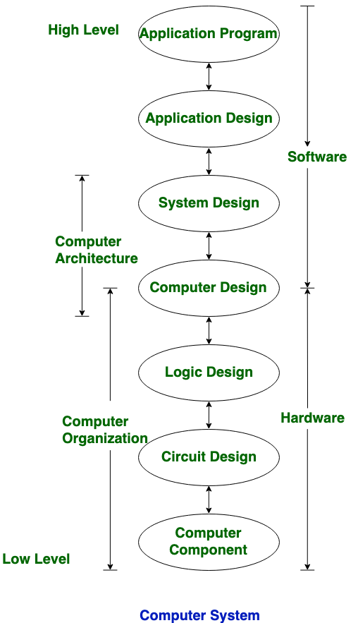
Computer architecture
Computer architecture comprises rules, methods, and procedures that describe the execution and functionality of the entire computer system. In general terms, computer architecture refers to how a computer system is designed using compatible technologies.
This chart will tell you how computer architecture is classified into a disciplinary method

Slide 4
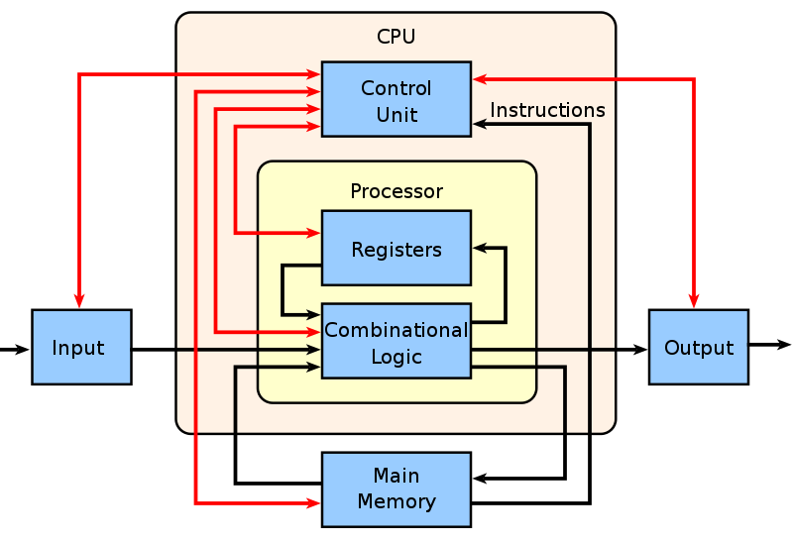
Computer architecture

Slide 5
Types of Computer Architecture
Here are the various categories of architecture that exist in our computer systems.
Von-Neumann Architecture
Harvard Architecture
Instruction Set Architecture
Micro-architecture
System Design

Slide 6
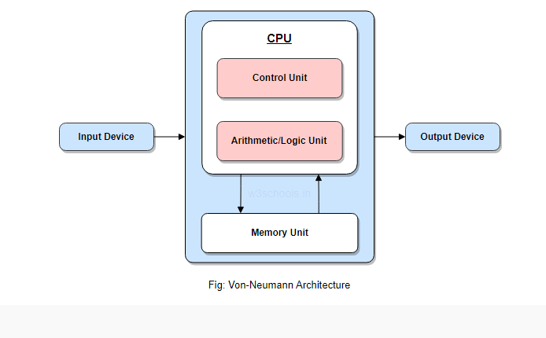
Von-Neumann Architecture (Neumann Model or Princeton Architecture)
A Central Processing Unit (CPU) with arithmetic and logic unit (ALU) and processors with attached registers.
A memory that can store data and instructions.
External mass storage or secondary storage.
A Control Unit (CU) with the ability to hold instructions in the program counter (PC) or instruction register (IR).
Input and output mechanisms and peripherals.

Slide 7
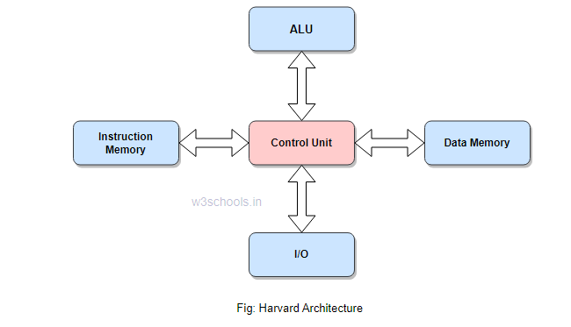
Harvard Architecture
Harvard Architecture consists of code and data laid in distinct memory sections. It requires a separate memory block for data and instruction. It has solely contained data storage within the Central Processing Unit (CPU). A single collection of clock cycles is needed. Data accessibility in one memory is done by a single memory location in the case of Harvard architecture.
One typical example is the Punch card. Moreover, modern computers may have the latest CPU processes for both methods but disparate them in a hardware design.
Harvard Architecture

Slide 8
Instruction Set Architecture
Another notable digital computer architecture is the Instruction Set Architecture. The architecture holds a collection of instructions that the processor renders and surmises. It consists of two instruction sets: RISC (Reduced Instruction Set Computer) and CISC (Complex Instruction Set Computer).
It enables versatile implementations of an ISA; commonly differ in features such as performance, physical size, and monetary price. It empowers the evolution of the micro-architectures, implementing ISA as an exclusive, higher-performance system that can run software on preceding generations of execution.

Slide 9
Micro-architecture
Micro-architecture is the structural design of a microprocessor. This computer organization leverages a method where the instruction set architecture holds a built-in processor. Engineers and hardware scientists implement instruction set architecture (ISA) with various micro-architectures that vary because of changing technology. It includes the technologies used, resources, and methods. Using this, the processors physically devised to administer a particular instruction set.
Simply, it is a logical form of all electronic elements and data pathways present in the microprocessor, designed in a specific way. It allows for the optimal completion of instructions. In academe, it is called computer organization.

Slide 10
System Design
System design itself defines a design that can serve user requirements like system architecture, computer modules having various interfaces, and data management within a system. The term product development is connective to the system design. It is the process by which we can take marketing information to create a product design.

Slide 11
Difference between Computer Architecture and Computer Organization:
No. | Computer Architecture | Computer Organization
1. | Architecture describes what the computer does. | The Organization describes how it does it.
2. | Computer Architecture deals with the functional behavior of computer systems. | Computer Organization deals with a structural relationship.
3. | In the above figure, it’s clear that it deals with high-level design issues. | In the above figure, it’s also clear that it deals with low-level design issues.
4. | Architecture indicates its hardware. | Whereas Organization indicates its performance.
5. | As a programmer, you can view architecture as a series of instructions, addressing modes, and registers. | The implementation of the architecture is called organization.
6. | For designing a computer, its architecture is fixed first. | For designing a computer, an organization is decided after its architecture.
7. | Computer Architecture is also called Instruction Set Architecture (ISA). | Computer Organization is frequently called microarchitecture.

Slide 12
Difference between Computer Architecture and Computer Organization:
8. | Computer Architecture comprises logical functions such as instruction sets, registers, data types, and addressing modes. | Computer Organization consists of physical units like circuit designs, peripherals, and adders.
9. | The different architectural categories found in our computer systems are as follows: Von-Neumann Architecture Harvard Architecture Instruction Set Architecture Micro-architecture and System Design | CPU organization is classified into three categories based on the number of address fields: Organization of a single Accumulator. Organization of general registers Stack organization
10. | It makes the computer’s hardware visible. | It offers details on how well the computer performs.
11. | Architecture coordinates the hardware and software of the system. | Computer Organization handles the segments of the network in a system.
12. | The software developer is aware of it. | It escapes the software programmer’s detection.
13. | Examples- Intel and AMD created the x86 processor. Sun Microsystems and others created the SPARC processor. Apple, IBM, and Motorola created the PowerPC. | Organizational qualities include hardware elements that are invisible to the programmer, such as interfacing of computer and peripherals, memory technologies, and control signals.

Slide 13
Five stages of RISC pipeline
Fetch, Decode, Execute, Memory, Write
Types of Code
There are five types of code we can write.
a load type, store type, branch, jump, or an R Type of code.
Each type of code performs different stages of the RISC pipeline.

Slide 14
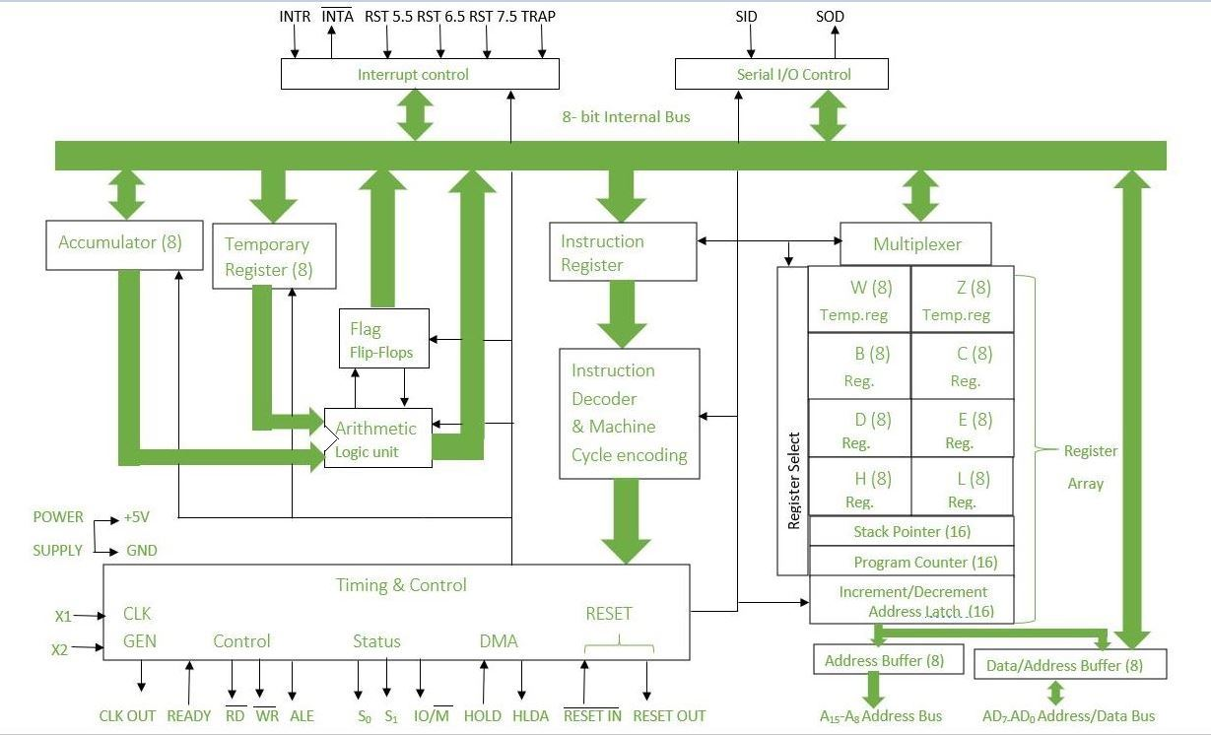
Units , 8085 microprocessor

Slide 15
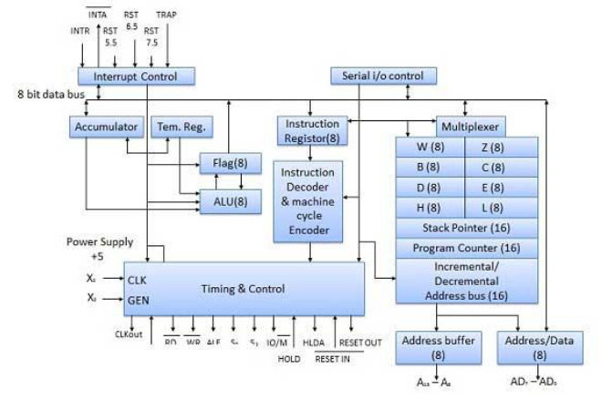
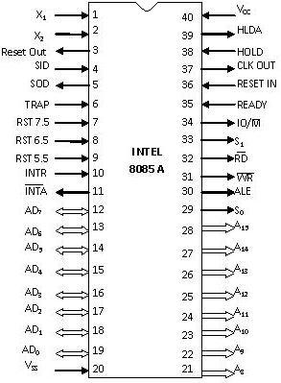

Slide 16
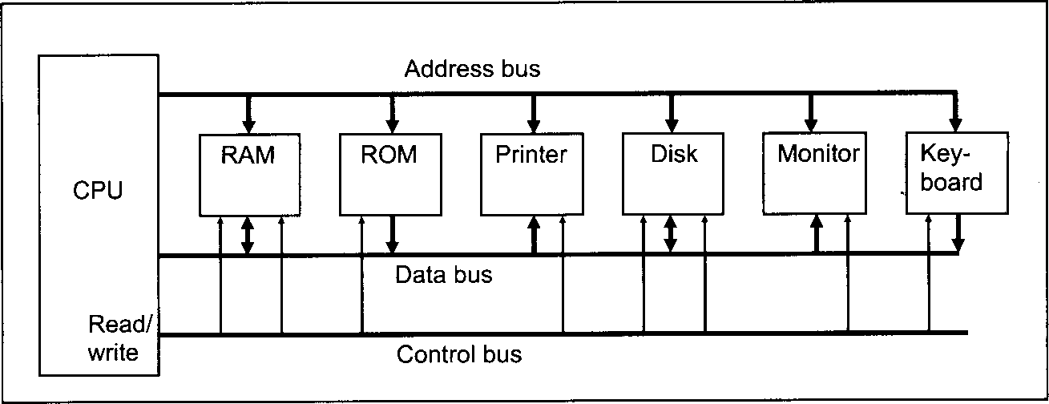
The 8085 Architecture
The 8085 uses three separate busses to perform its operations
The address bus.
The data bus.
The control bus.

Slide 17
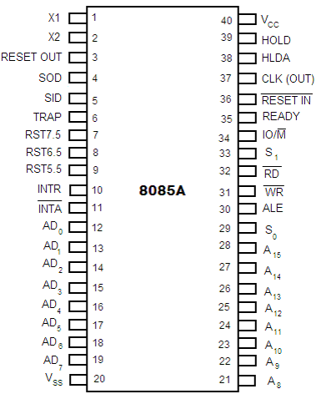
8085 INTRODUCTION
Q What are the main features of the 8085 microprocessor?
It is an 8 bit processor.
It is a single chip device with 40 pins.
It has multiplexed address and data bus (AD0-AD7).
It works on 5 Volt dc power supply.
The maximum clock frequency is 3 MHz while minimum frequency is 500kHz.
It provides 74 instructions with 5 different addressing modes.
8085 Pin Diagram

Slide 18
8085 INTRODUCTION
It provides 16 address lines so it can access 2¹⁶ =64K bytes of memory.
It generates 8 bit I/O address so it can access 2⁸=256 input ports.
It provides 5 hardware interrupts : TRAP, RST 5.5, RST 6.5, RST 7.5,INTR.
It provides Acc (Accumulator), one flag register, 6 general purpose registers and two special purpose registers(SP,PC).
It provides serial lines SID, SOD. So serial peripherals can be interfaced with 8085 directly.

Slide 19
The 8085 busses
8085 Address Bus
  16 bits wide (A₀ A₁………A₁₅)
    Therefore, the 8085 can access locations with numbers from (0 to 65,536). Or, the 8085 can access a total of 64K addresses.
  “Unidirectional”.
    Information flows out of the microprocessor and into the memory or peripherals.
  When the 8085 wants to access a peripheral or a memory location, it places the 16-bit address on the address bus and then sends the appropriate control signals.

Slide 20
The 8085 busses
2- 8085 Data Bus
8 bits wide (D0 ,D2, D3, D4, D5, D6, D7)
“Bi-directional”.
  Information flows both ways between the microprocessor and memory or I/O.
The 8085 uses the data bus to transfer the binary information.
3- 8085 Control Bus
There is no real control bus. Instead, the control bus is made up of a number of single bit control signals such as RD, WR, M/IO, READY, HOLD, etc.

Slide 21
Operation Types in a Microprocessor
Q What are the three types of the microprocessor operations.
All of the operations of the microprocessor can be classified into one of
three types:
Microprocessor-Initiated Operations
Internal Operations
Peripheral-Initiated Operations

Slide 22
Microprocessor-Initiated Operations
Q What are the microprocessor –initiated operations These are operations that the microprocessor itself starts. These are usually one of 4 operations:
Memory Read
Memory Write
I/O Read (Get data from an input device)
I/O write (Send data to an output device)

Slide 23
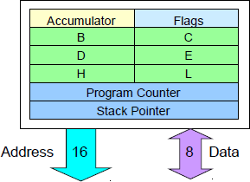
Internal Data Operations
The 8085 can perform a number of internal operations. Such as
Storing data
Arithmetic Logic operations,
Testing for condition, etc.
To perform these operations, the microprocessor needs an internal architecture
Q What are the internal Data Operations of the microprocessor?

Slide 24
Externally-Initiated Operations
Q What are the External initiated operation of the microprocessor?
1- Reset
All operations are stopped and the program counter is reset to 0000.
2- Interrupt
The microprocessor’s operations are interrupted executes what is called a “service routine”.
and the microprocessor
This routine “handles” the interrupt, (perform the necessary operations). Then the microprocessor returns to its previous operations and continues.

Slide 25
Externally-Initiated Operations
Ready
The 8085 has a pin called RDY. This pin is used by external devices to stop the 8085 until they catch up.
As long as the RDY pin is low, the 8085 will be in a wait state.
Hold
The 8085 has a pin called HOLD. This pin is used by external devices to gain control of the busses.
When the HOLD signal is activated by an external device, the 8085 stops executing instructions and stops using the busses.
This would allow external devices to control the information on the busses. Example Direct Memory Access (DMA).

Slide 26
The Internal Architecture of the 8085 CPU
Registers
Six general purpose registers used to store 8-bit data during a program execution.
The registers are identified as B, C, D, E, H, and L.
They can be combined as register pairs: BC, DE, and HL to perform 16-bit operations.
1- Accumulator
8-bit register that is part of the ALU
Used to store 8-bit data and in performing 8-bit arithmetic and logical operations, and in storing the results op operations

Slide 27
The Internal Architecture
2- 8085 Flag Register
It is a group of 5 flip flops used to know status of various operations done.
The Flag Register along with Accumulator is called PSW or Program Status Word.
3- The Program Counter (PC)
This is a register that is used to control the sequencing of the execution of instructions.
This register always holds the address of the next instruction.
Since it holds an address, it must be 16 bits wide.

Slide 28
The Internal Architecture
4- The 8085 Stack pointer
Q What are the features of the 8085 stack pointer?
The stack pointer is also a 16-bit register that is used to point into memory.
The memory this register points to is a special area called the stack.
The stack is an area of memory used to hold data that will be retrieved soon.
The stack is usually accessed in a Last In First Out (LIFO). fashion

Slide 29
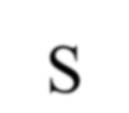
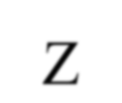
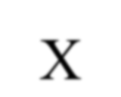

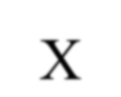
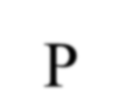







The Internal Architecture
8085 Flag Register Bits:
Flag Register is given by:
S: Sign flag is set when result of an operation is negative. Z: Zero flag is set when result of an operation is 0.
AC: Auxiliary carry flag is set when there is a carry out of lower nibble or lower four bits of the operation.
CY: Carry flag is set when there is carry generated by an operation.
P: Parity flag is set when result contains even number of 1’s.
Rest are don’t care flip flops.
S | Z | X | AC | X | P | X | CY

Slide 30
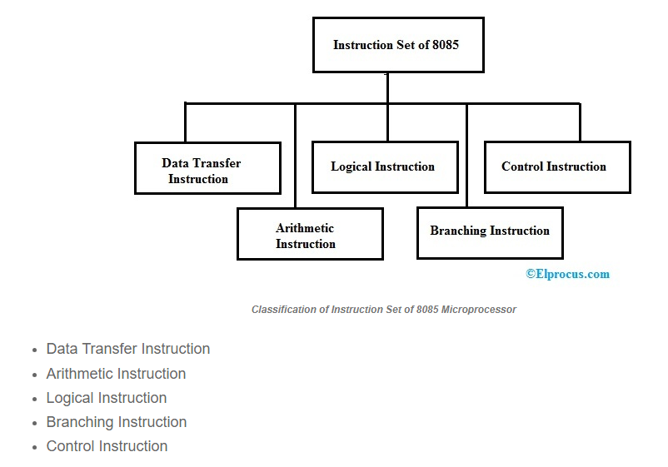

Slide 31
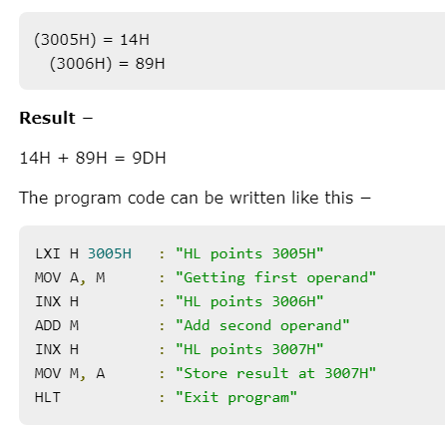
Adding Two 8-bit Numbers
Write a program to add data at 3005H & 3006H memory location and store the result at 3007H memory location.

Slide 32
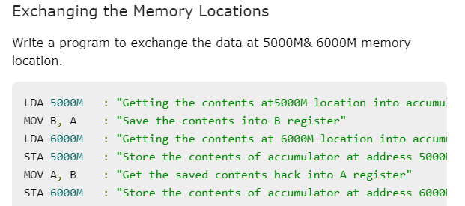

Slide 33
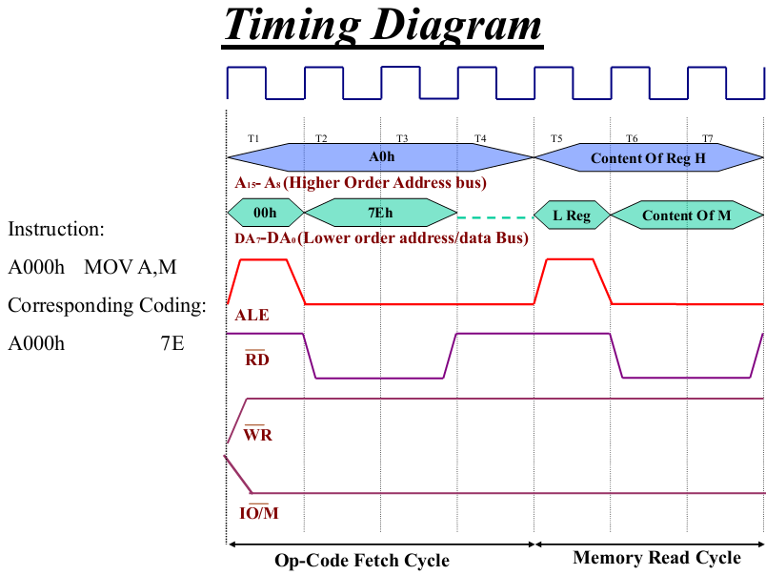
A000h MOV ….. …..
Q(1)
M or A
M or A

Slide 34
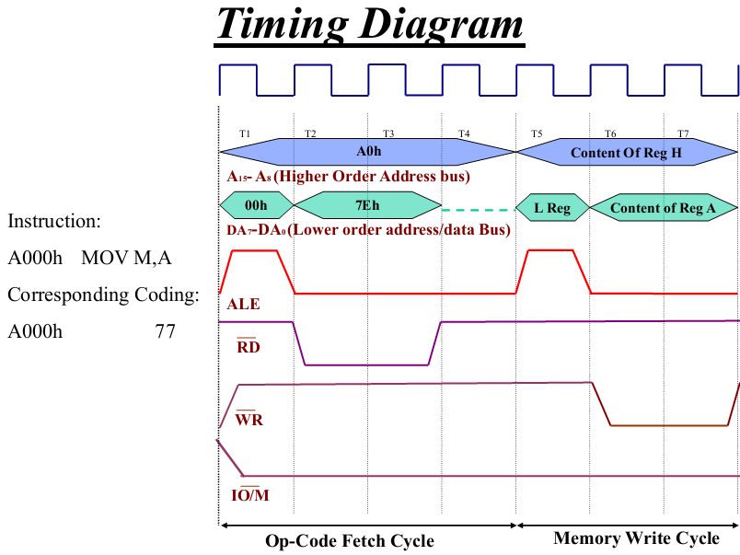
A000h MOV ….. …..
Q(2)
M or A
M or A

Slide 35
Summary microprocessor 8085

Slide 36
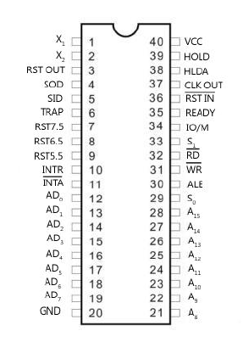
Pin configuration of 8085 μp.
All the signal can be classified into six groups

Slide 37
1. Address bus
8085 requires 8-bit data bus and 16-bit address bus, as the memory address is of 16 bits.
So whenever 16-bit address is transmitted by the microprocessor 8 MSBs of the address lines are sent on the Address Bus (A15-A8) and 8 LSBs of the lines are sent on the Address/Data Bus (AD7- AD0).
The 8085 microprocessor has 8 signal line, A15 - A8 which are unidirectional and used as a high order address bus.

Slide 38
2. Data bus
The signal line AD7 - AD0 are bi-directional for dual purpose. They are used as low order address bus as well as data bus.
3. Power supply And frequency signal
Vcc − +5v power supply.
Vss − ground reference.
X1, X2− A crystal is connected at these two pins. The frequency is internally divided by two operate system at 3-MHz, the crystal should have a frequency of 6-MHz.
CLK out − This signal can be used as the system clock for other devices.

Slide 39
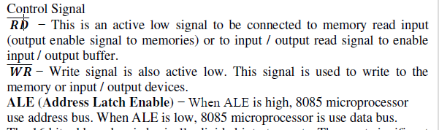

4. Control signal and Status signal

Slide 40

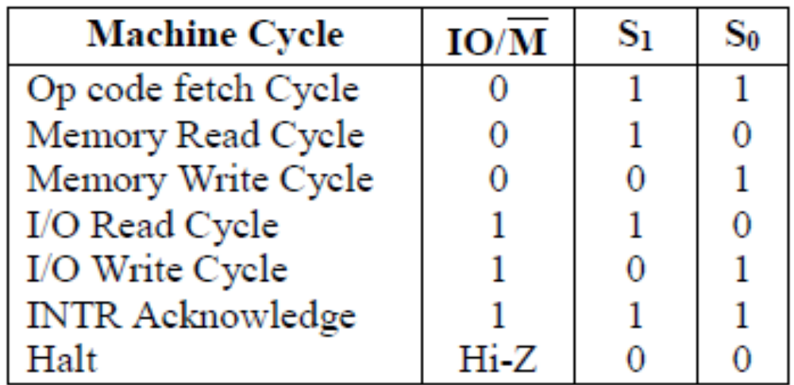
4. Control signal and Status signal

Slide 41
5. Serial I/O ports
For this purpose two pins SID and SOD are provided in the serial input/output control unit.
The SID (Serial Input Data) terminal receives the serial data stream from an input device, the control unit converts serial data stream to parallel data before it is used by the computer. After the conversion 8-bit parallel data is stored in the accumulator.
Similarly, SOD (Serial Out Data) terminal outputs the 8-bit parallel available with the accumulator into serial form to the peripheral device connected with the computer.

Slide 42
6. Externally initiated signal
◻ HOLD and HLDA (Hold Acknowledge) signals are used for DMA (Direct Memory Access) operation. In a microprocessor, the data transfer between I/O devices and memory will take place through the microprocessor.
The HOLD and HLDA signals are used in the operation. Whenever HOLD signal is high, CPU temporarily relinquishes its operation by floating the address, data and control buses; and DMA operation is started. A high HLDA (Hold Acknowledge) signal is also sent to DMA controller, indicating that CPU has received the hold request. Whenever the data transfer is complete, then the control to CPU is returned back by sending a HOLD signal. Further the HLDA signal goes low.

Slide 43
6. Externally initiated signal
READY signal is used. If the READY signal is high the peripheral device is ready and the processor can complete the data transfer. If this signal is low the microprocessor waits (by generating a number of NOP T-states) till it goes high.
RESET in may be low from the operator Reset button or from the processor. When the signal is low, the CPU will reset the program counter, instruction register and other circuits. It also sends a high RESET OUT. The RESET OUT signal goes to peripheral devices to reset or initialized.
When signal RESET in̅ goes high and RESET OUT goes low, the data processing may begin.

Slide 44
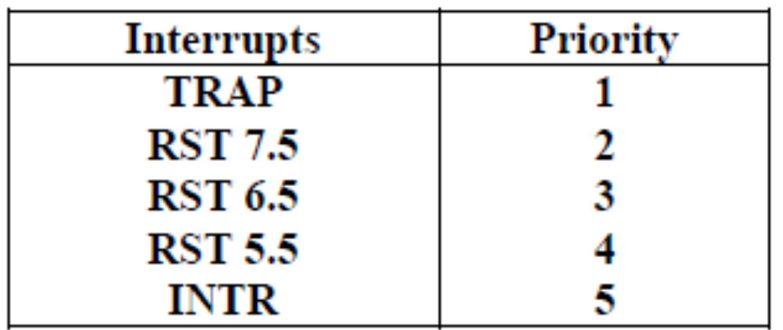
6. Externally initiated signal
Interrupt Control: necessary to interrupt the execution of the main program. For this an interrupt request is obtained from the I/O devices.
After receiving the interrupt request (INTR), processor temporarily stops what it was doing and attends to the I/O device. (INTA) is an interrupt acknowledge signal which is sent by the microprocessor after INTR signal is received.

Slide 45
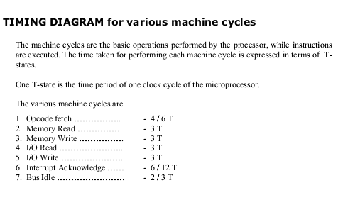

Slide 46
Instruction cycle
Instruction: A command given to the microprocessor to perform an operation
Program : A set of instructions given in a sequential manner to perform a particular task
The CPU fetches one instruction from memory at a time & executes it.
Instruction cycle = Fetch cycle + Execute cycle

Slide 47
Fetch Cycle : The steps taken by CPU to fetch the opcode from the memory
The time taken for fetch cycle is fixed.
Execute Cycle : The steps taken by CPU to fetch data & to perform the operation specified in the instruction
The time taken for execute cycle is variable which depends on the type of instruction ,i.e. 3 –byte , 2-byte & 1-byte instruction.

Slide 48
Machine cycle
The time required by the micro processor to complete the operation of accessing memory or I/O device .
Operations like :
Opcode fetch
Memory read
Memory write
I/O read
I/O write

Slide 49
T - states
Microprocessor performs an operation in specific clock cycles.
Each clock cycle is called as T –States.
The number of T – states required to perform an operation is called Machine Cycle .

Slide 50
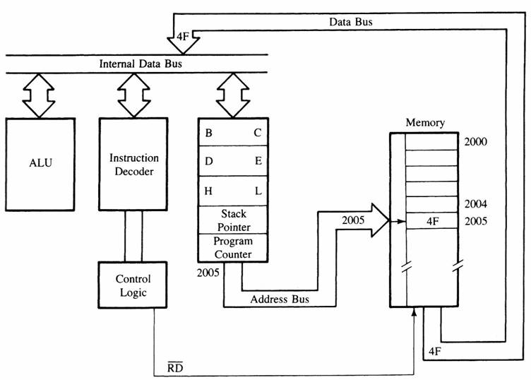
MPU Communication and Bus Timing
Figure 3: Moving data form memory to MPU using instruction MOV C, A (code machine 4FH = 0100 1111)

Slide 51
MPU Communication and Bus Timing
The Fetch Execute Sequence :
  1. The μp placed a 16 bit memory address from PC (program counter) to address bus.
    Figure 4: at T1
      The high order address, 20H, is placed at A15 – A8.
      the low order address, 05H, is placed at AD7 - AD0 and ALE is active high.
      Synchronously the IO/M is in active low condition to show it is a memory operation.
  2. At T2 the active low control signal, RD, is activated so as to activate read operation; it is to indicate that the MPU is in fetch mode operation.

Slide 52
MPU Communication and Bus Timing
  3. T3: The active low RD signal enabled the byte instruction, 4FH, to be placed on AD7 – AD0 and transferred to the MPU. While RD high, the data bus will be in high impedance mode.
  4. T4: The machine code, 4FH, will then be decoded in instruction decoder. The content of accumulator (A) will then copied into C register at time state, T4.

Slide 53
S₀ and S₁
Pin 29 (Output) and Pin 33 (Output)
S₀ and S₁ are called Status Pins.
They tell the current operation which is in progress in 8085.
S₁ | S₀ | Operation
0 | 0 | Halt
0 | 1 | Write
1 | 0 | Read
1 | 1 | Opcode Fetch

Slide 54
Table Showing IO/M, S₀, S₁ and Corresponding Operations
Operations | IO/M | S₁ | S₀
Opcode Fetch | 0 | 1 | 1
Memory Read | 0 | 1 | 0
Memory Write | 0 | 0 | 1
I/O Read | 1 | 1 | 0
I/O Write | 1 | 0 | 1
Interrupt Ack. | 1 | 1 | 1
Halt | High Impedance | 0 | 0

Slide 55
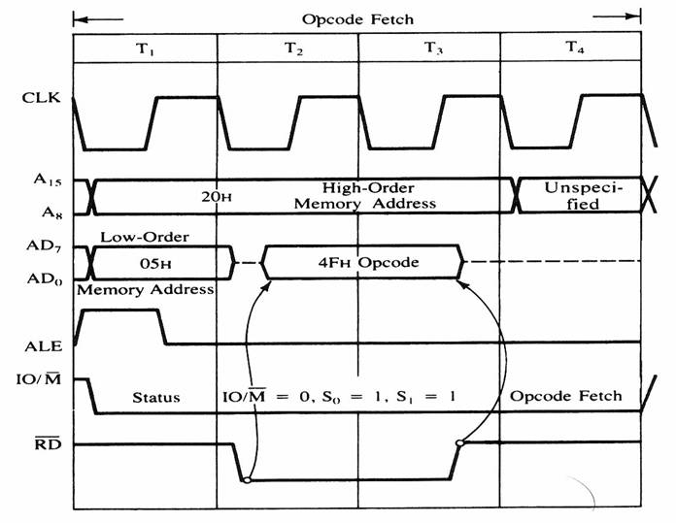
MPU Communication and Bus Timing
Figure 4: 8085 timing diagram for Opcode fetch cycle for MOV C, A .

Slide 56
Memory Read: The flow of data from the memory to the microprocessor.
Step 1(T1) : microprocessor places the address on the address lines from program counter & activates ALE signal to multiplex the low order address.
It also sends status signals IO/M = 0, S₁=1, S₀ =0 for memory read operation.
Step 2 (T2) : SE

Slide 57
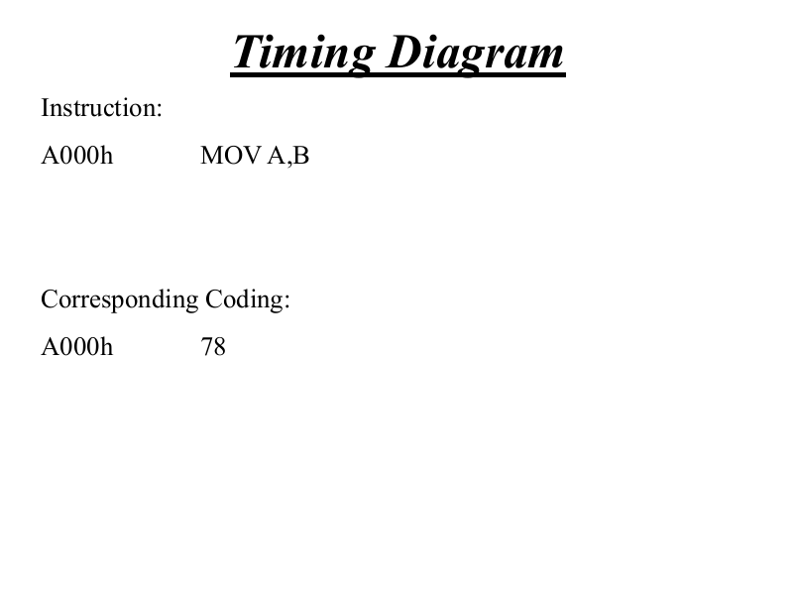

Slide 58
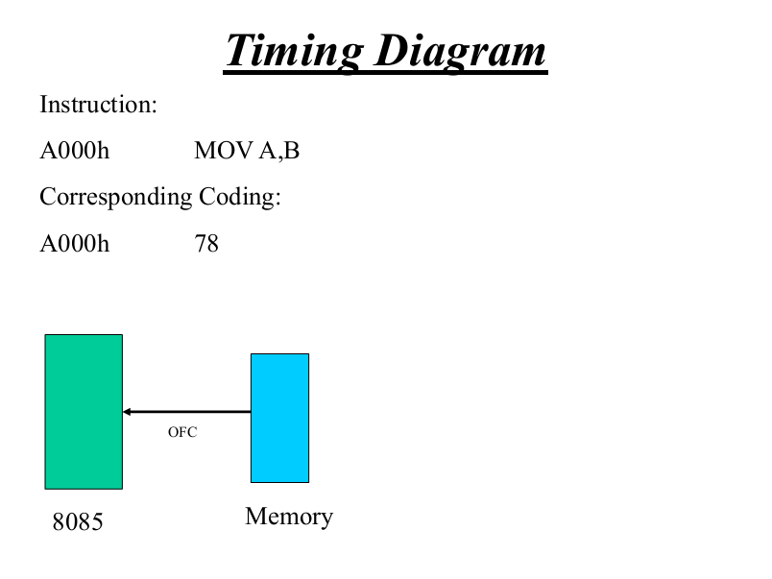

Slide 59
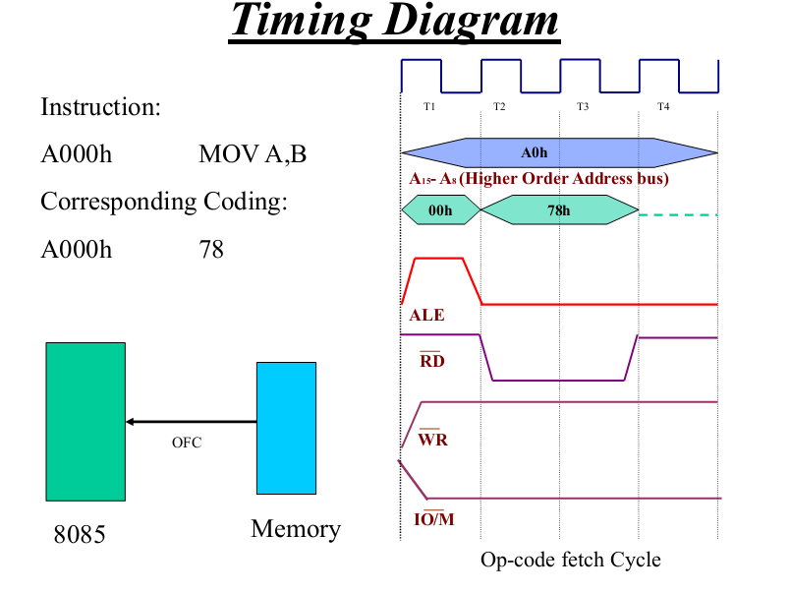

Slide 60
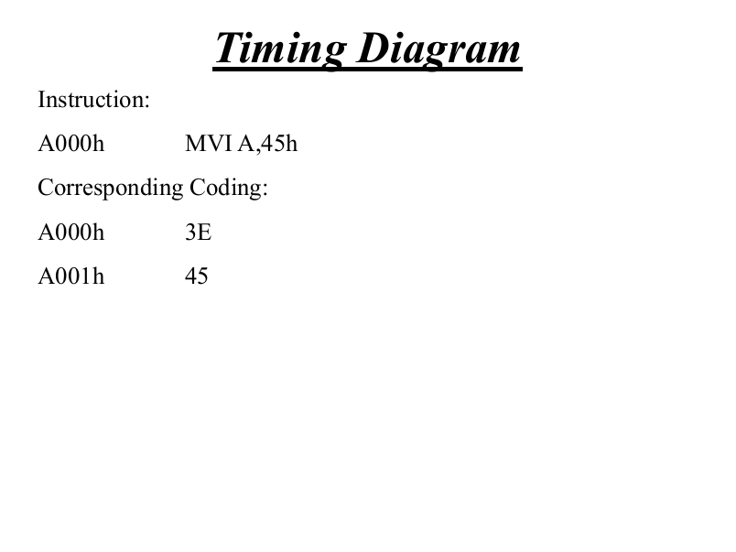

Slide 61
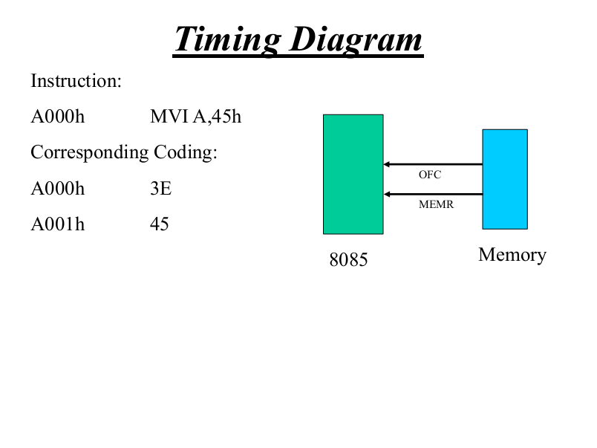

Slide 62
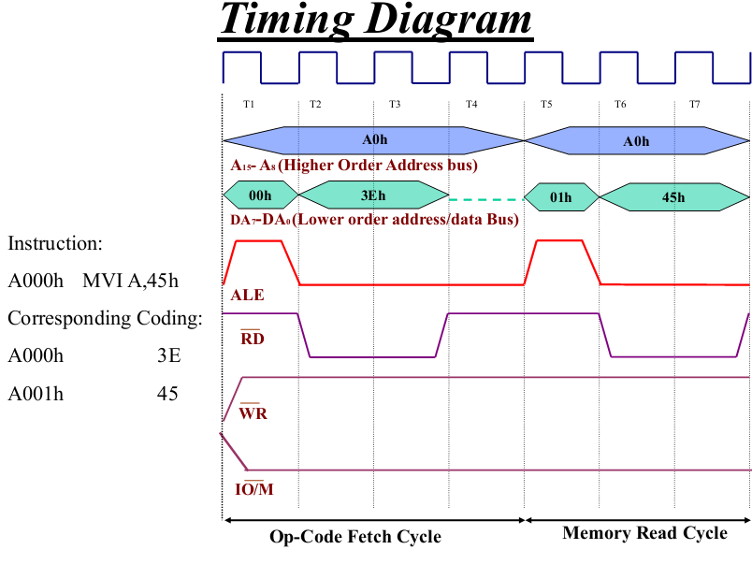

Slide 63
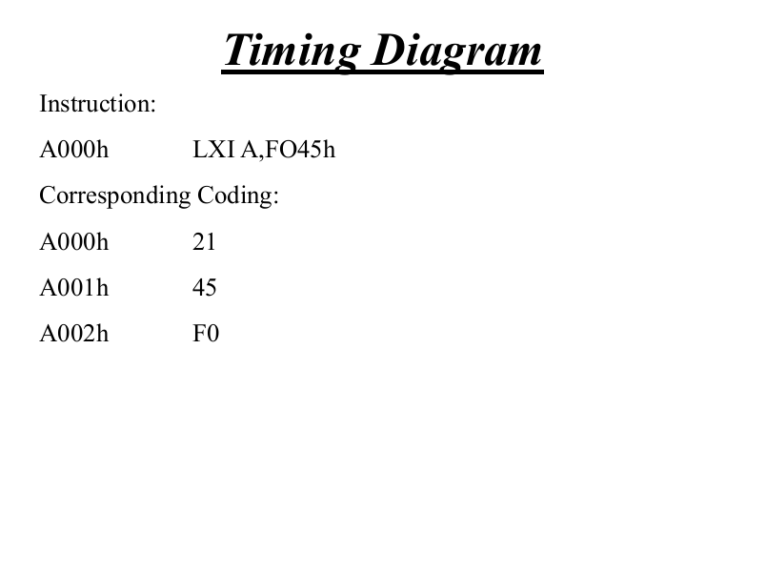

Slide 64
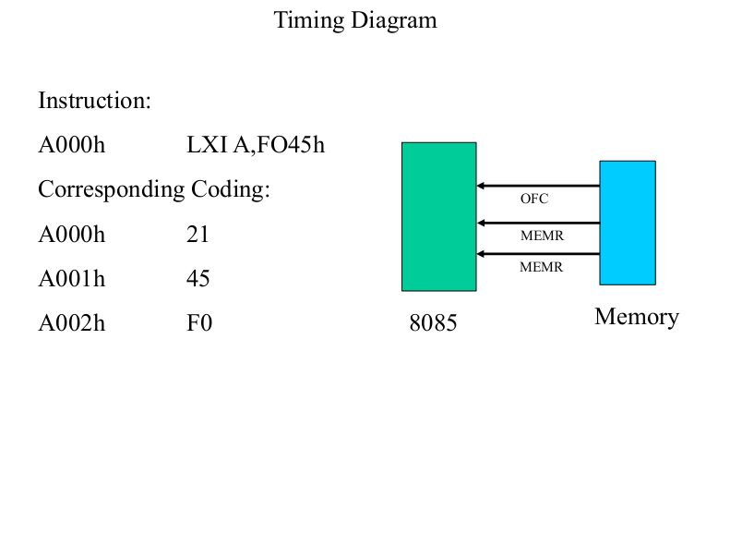
LXI H, Data

Slide 65
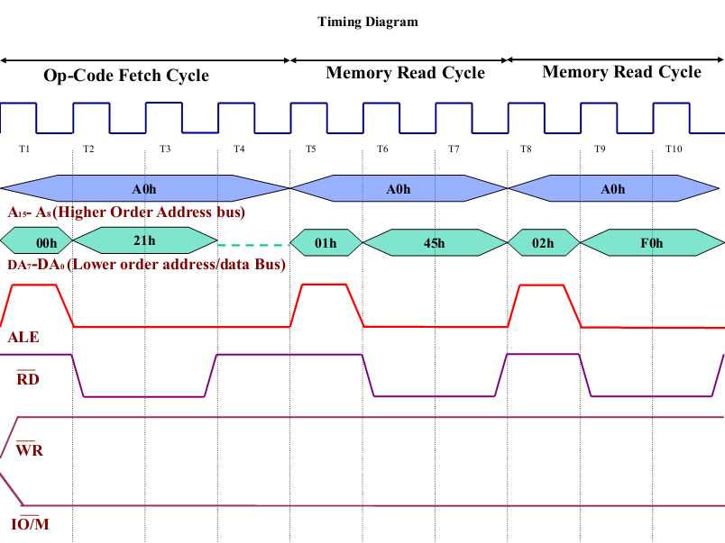

Slide 66
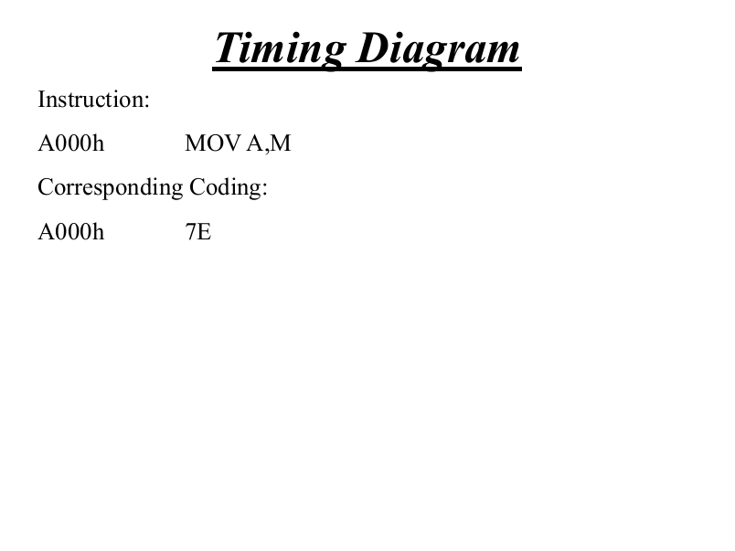

Slide 67
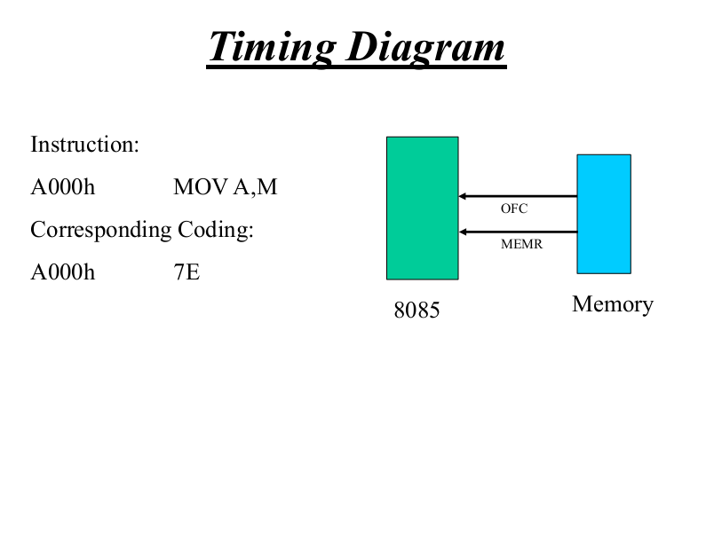

Slide 69
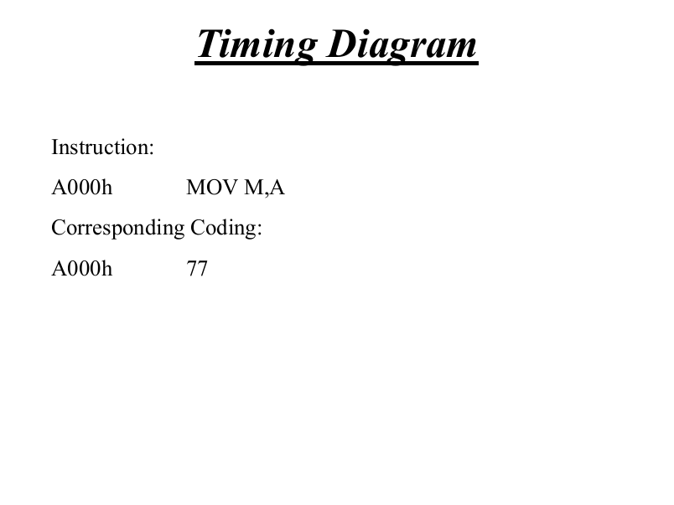

Slide 70


Slide 72

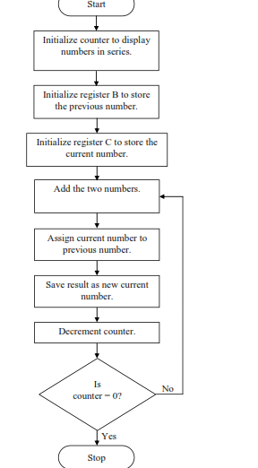

Slide 73
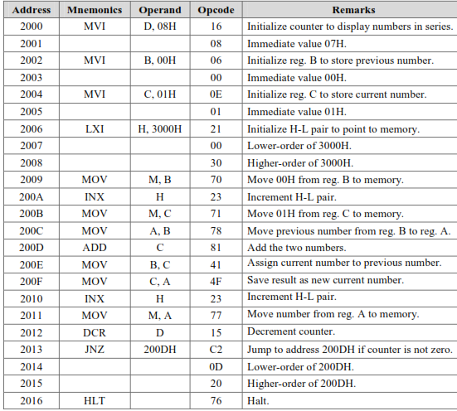

Slide 74
