Slide 1
Thevenin Theorem
Application

Slide 2
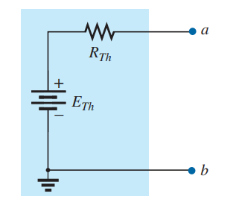
Thevenin Theorem, procedure of application
It is used when the CKT has many sources , has one of its element is variable and it is required to find the current or voltage of this element for its different values.
The theorem states that” Any two-terminal dc network can be replaced by an equivalent circuit consisting solely of a voltage source and a series resistor as shown in Fig. below”

Slide 3
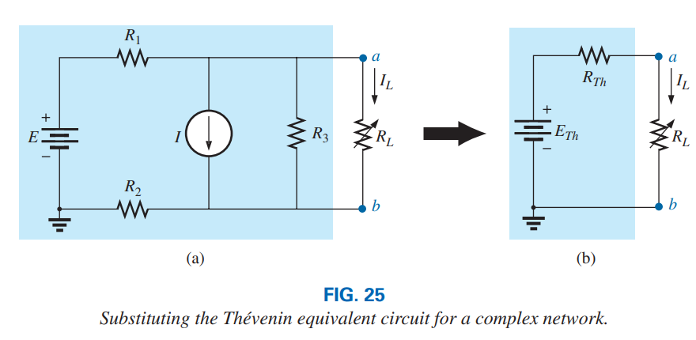
Procedure of application
1. Remove that portion of the network where the Thévenin equivalent circuit is found. In Fig. 25(a), this requires that the load resistor RL be temporarily removed from the network.
2. Mark the terminals of the remaining two-terminal network. (The importance of this step will become obvious as we progress through some complex networks.) RTh:

Slide 4
continue
3. Calculate RTh by first setting all sources to zero (voltage sources are replaced by short circuits and current sources by open circuits) and then finding the resultant resistance between the two marked terminals. (If the internal resistance of the voltage and/or current sources is included in the original network, it must remain when the sources are set to zero.)
ETh:
4. Calculate ETh by first returning all sources to their original position and finding the open-circuit voltage between the marked terminals. (This step is invariably the one that causes most confusion and errors. In all cases, keep in mind that it is the open circuit potential between the two terminals marked in step 2.)

Slide 5
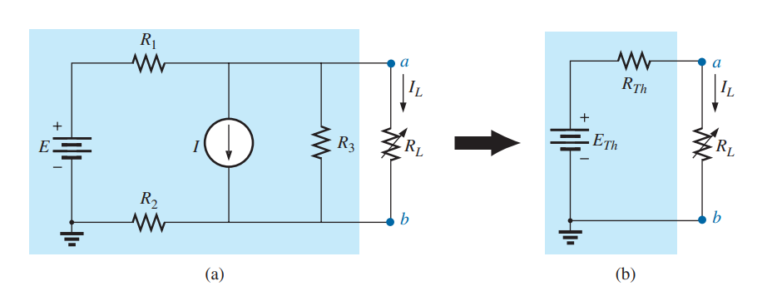
continue
Conclusion:
5. Draw the Thévenin equivalent circuit with the portion of the circuit previously removed replaced between the terminals of the equivalent circuit. This step is indicated by the placement of the resistor RL between the terminals of the Thévenin equivalent circuit as shown in Fig. 25(b)

