Slide 1
Thevenin Theorem
Examples

Slide 2
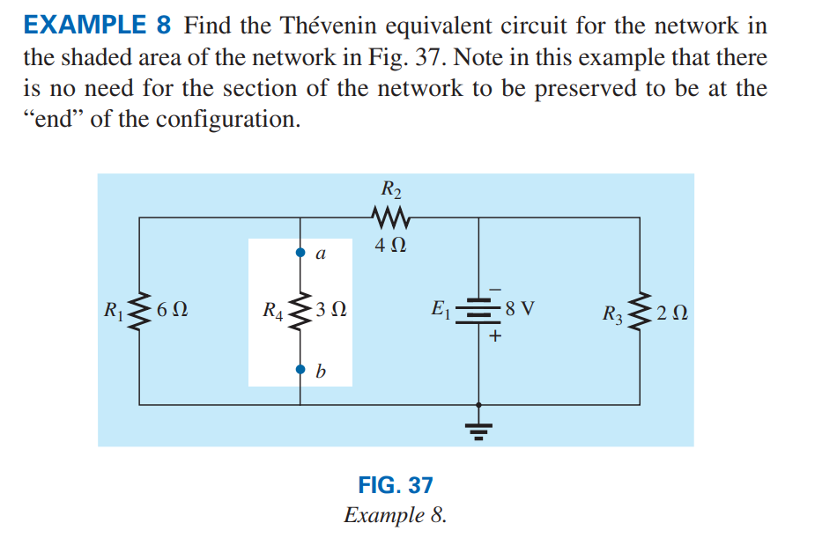
Example 1

Slide 3
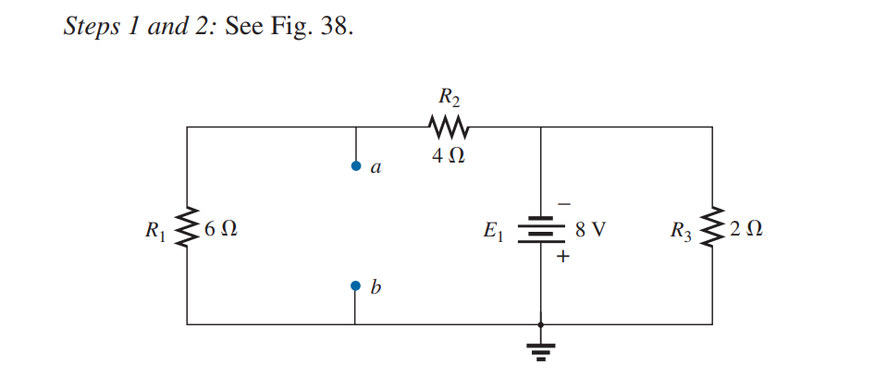
Solution

Slide 4
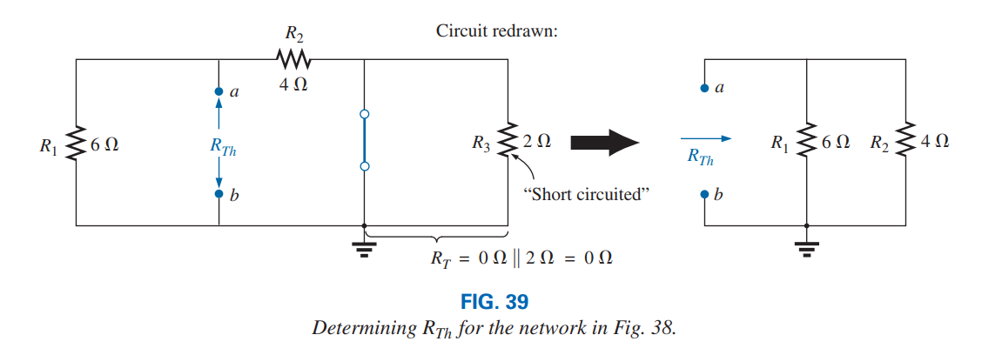
continue

Slide 5
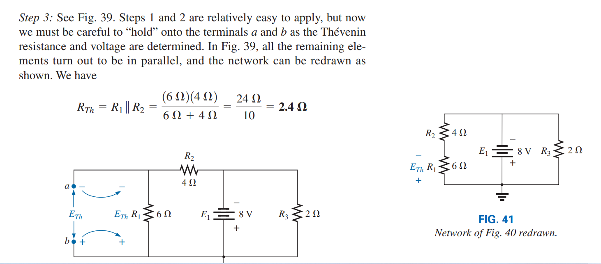
continue

Slide 6
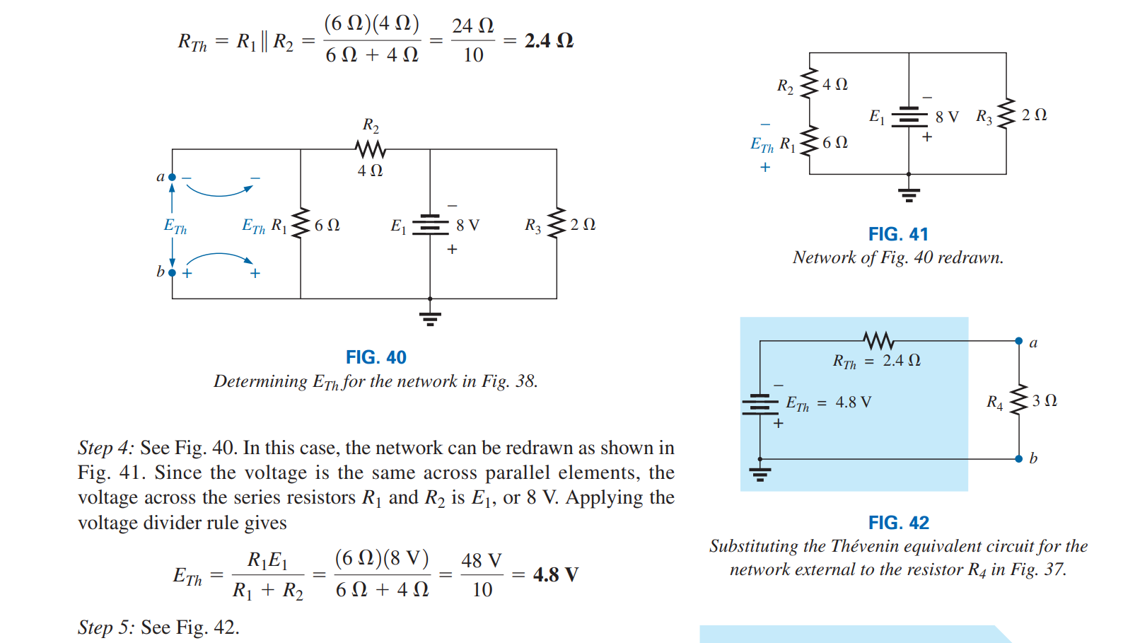
continue

Slide 7
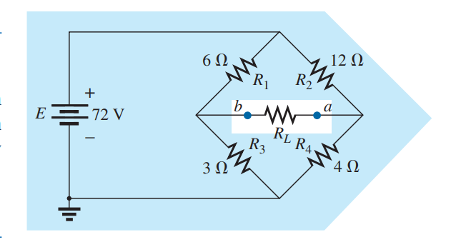
Example 2
Find the Thévenin equivalent circuit for the network in the shaded area of the bridge network in Fig. 43.

Slide 8
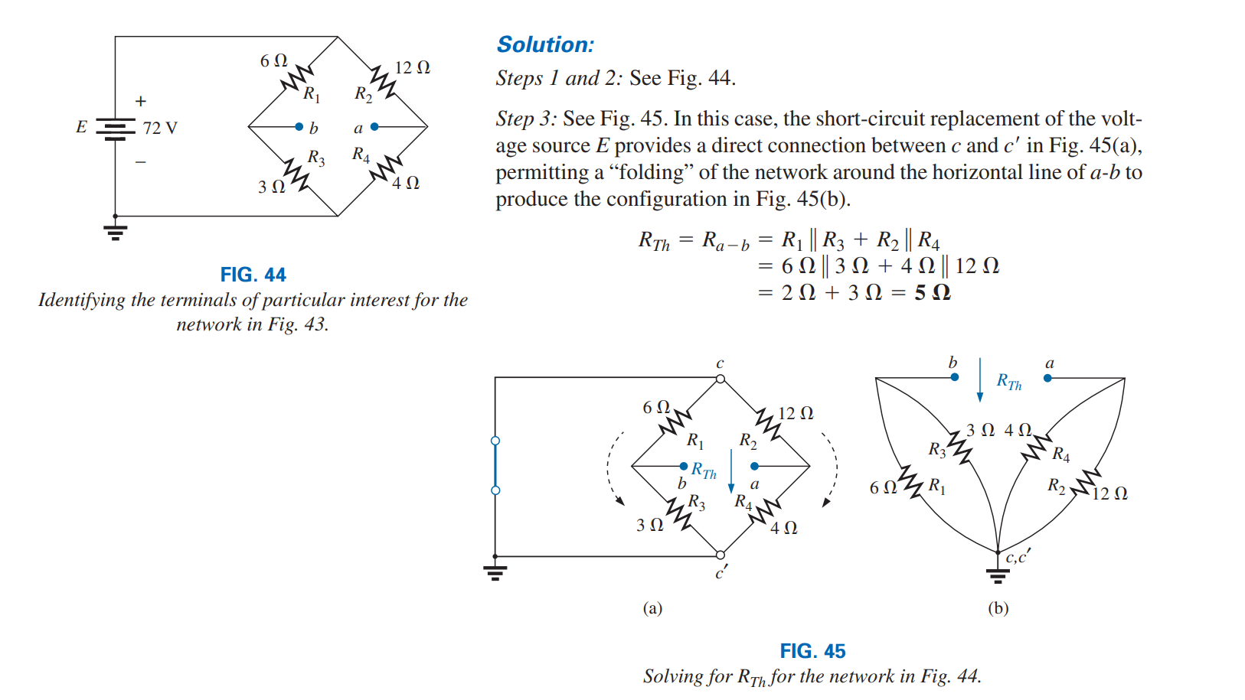
Solution

Slide 9
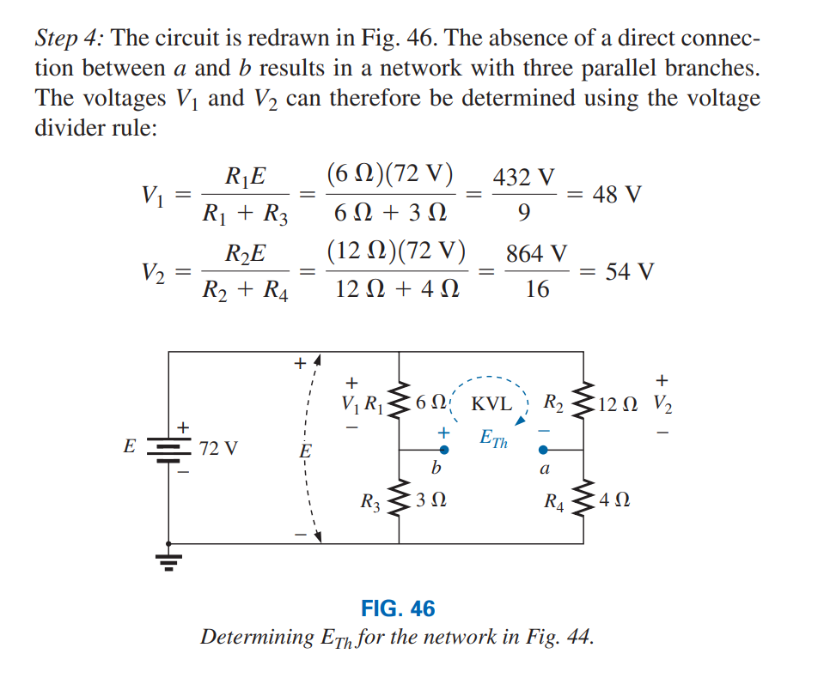
continue

Slide 10
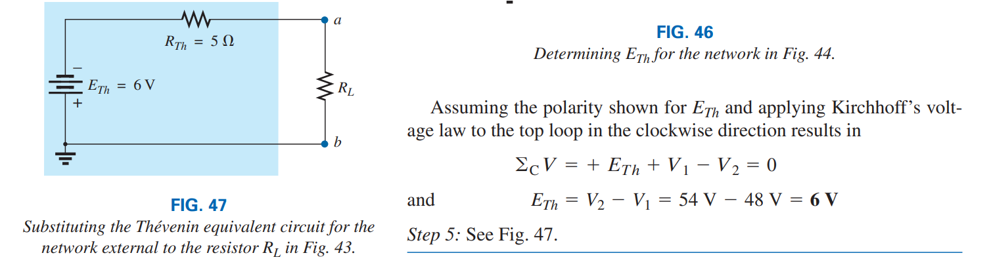
continue

