Slide 1
Multichannel Transmission
Technique
Introduction

Slide 2
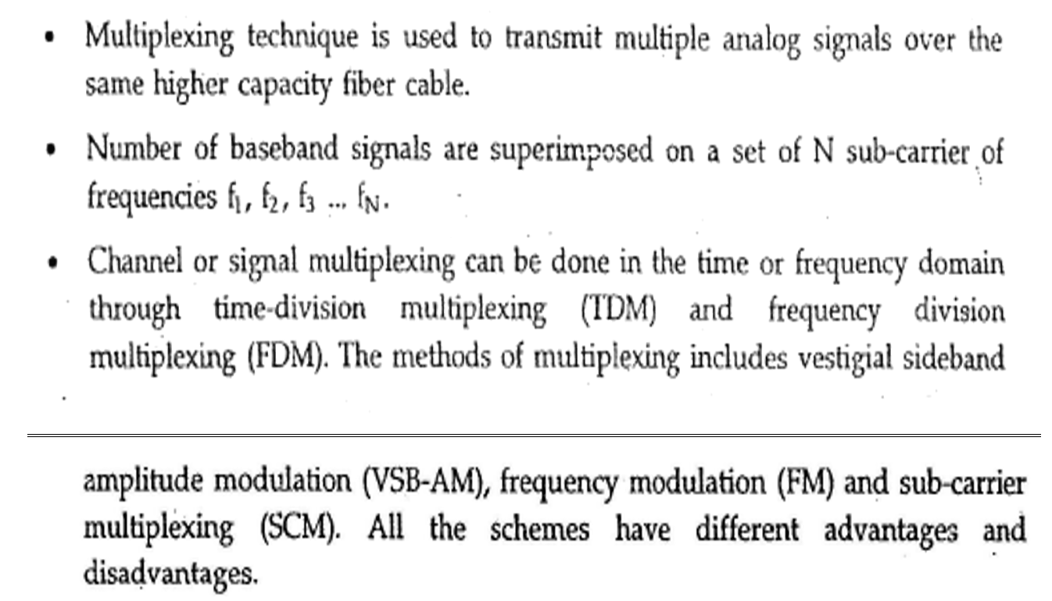
Multichannel technique

Slide 3
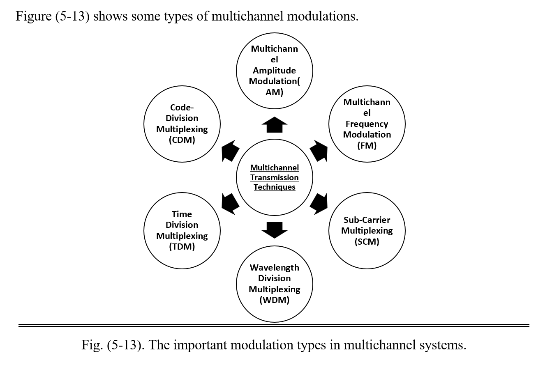

Slide 4
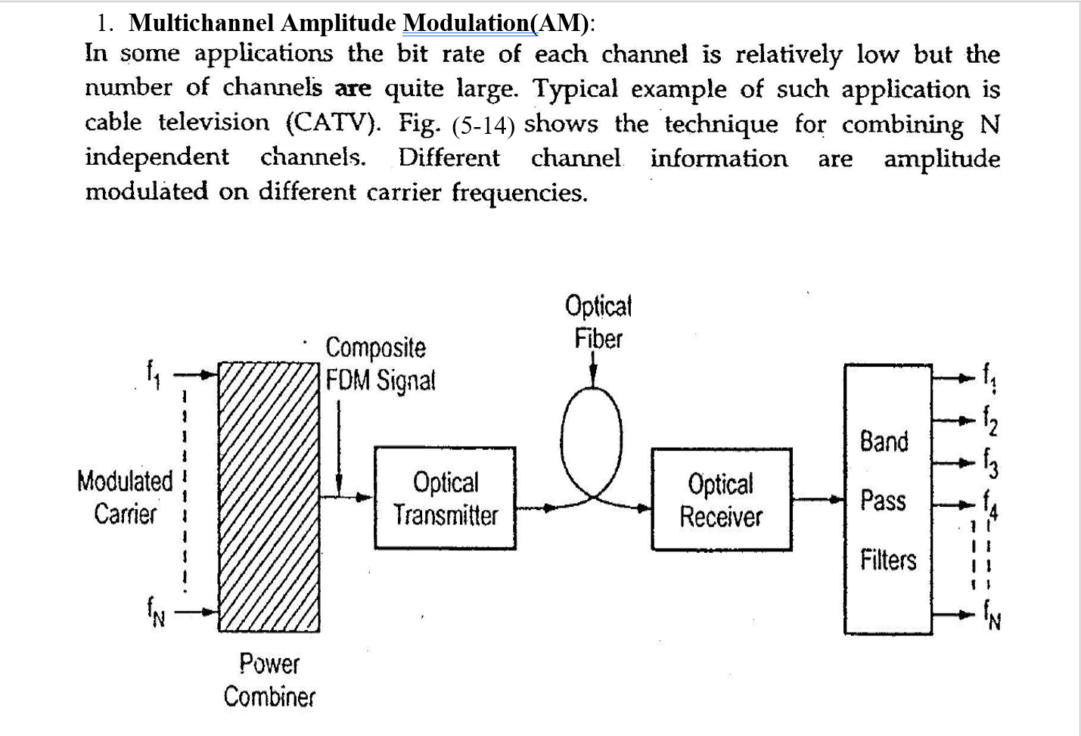
Multi transmission techniques details

Slide 5
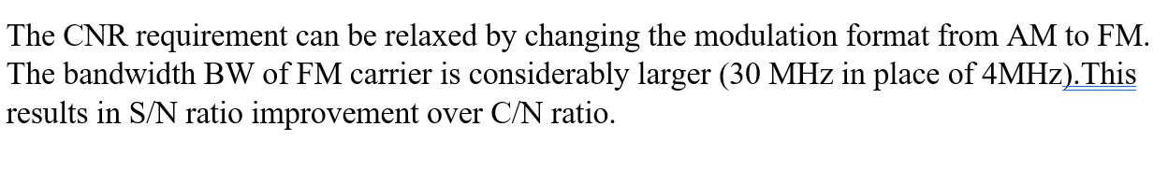
Multi channel Frequency modulation

Slide 6
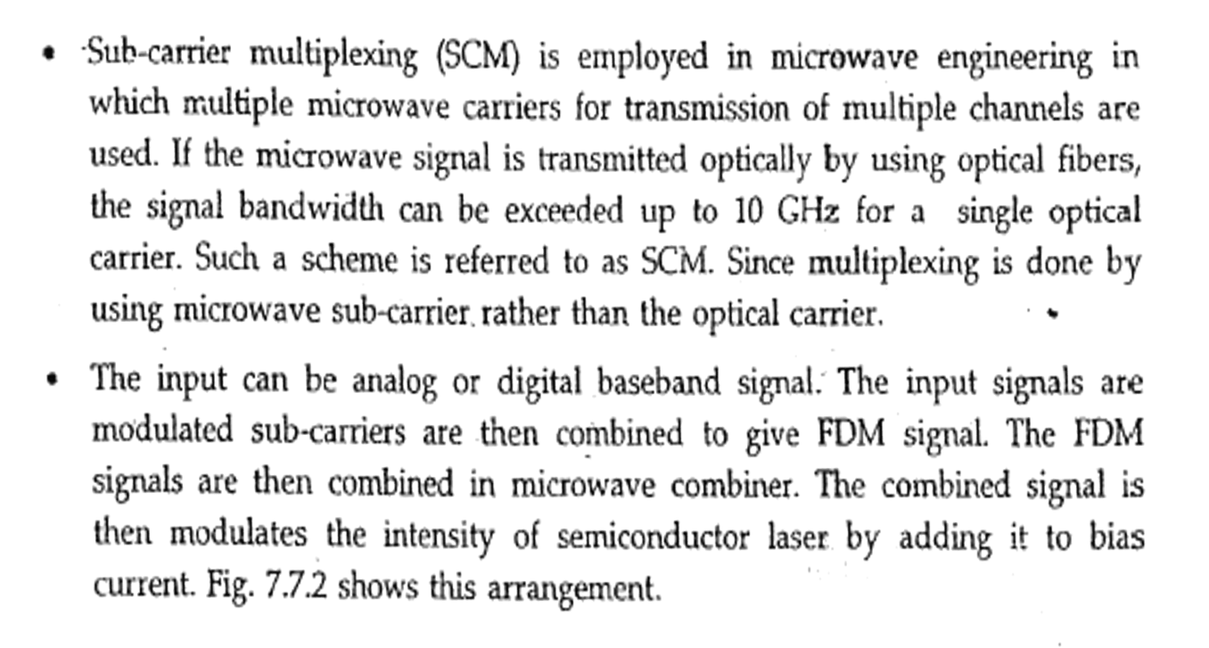
Sub-Carrier Multiplexing (SCM)

Slide 7
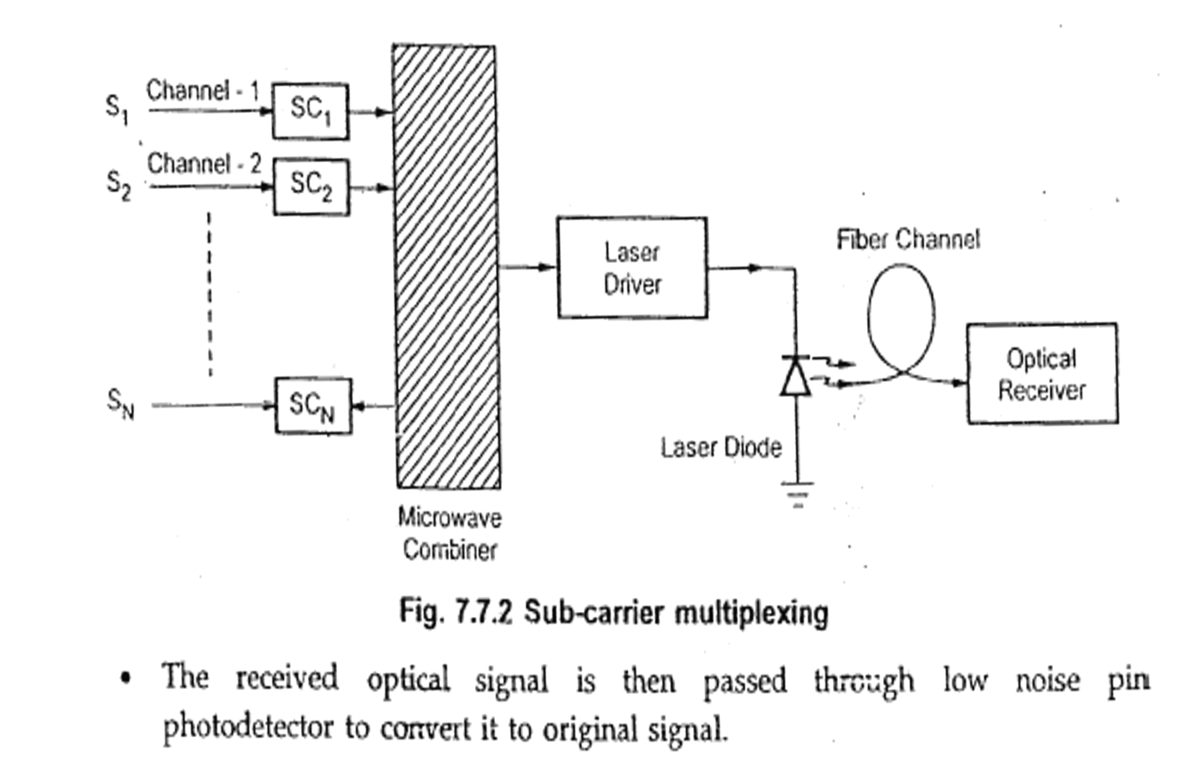

Slide 8
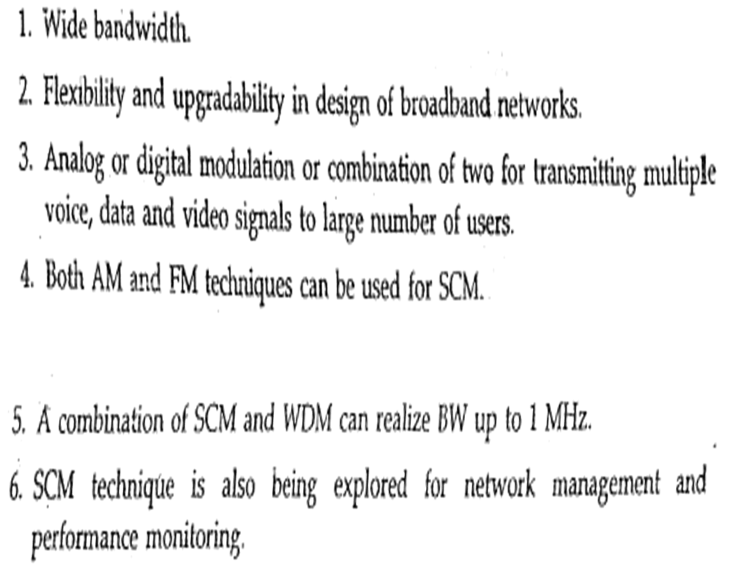
Advantages of SCM

Slide 9
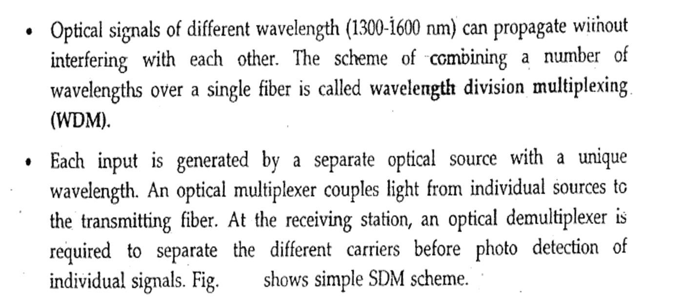
5-6: Wavelength Division Multiplexing (WDM):

Slide 10
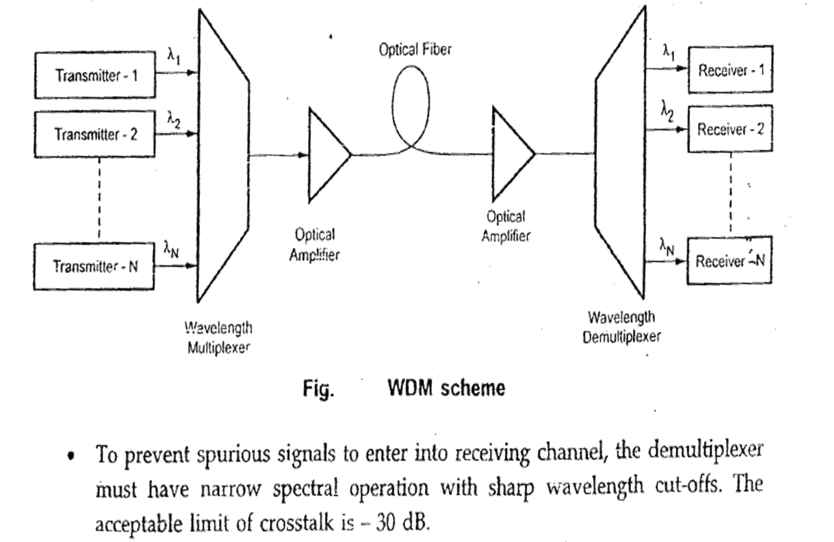

Slide 11
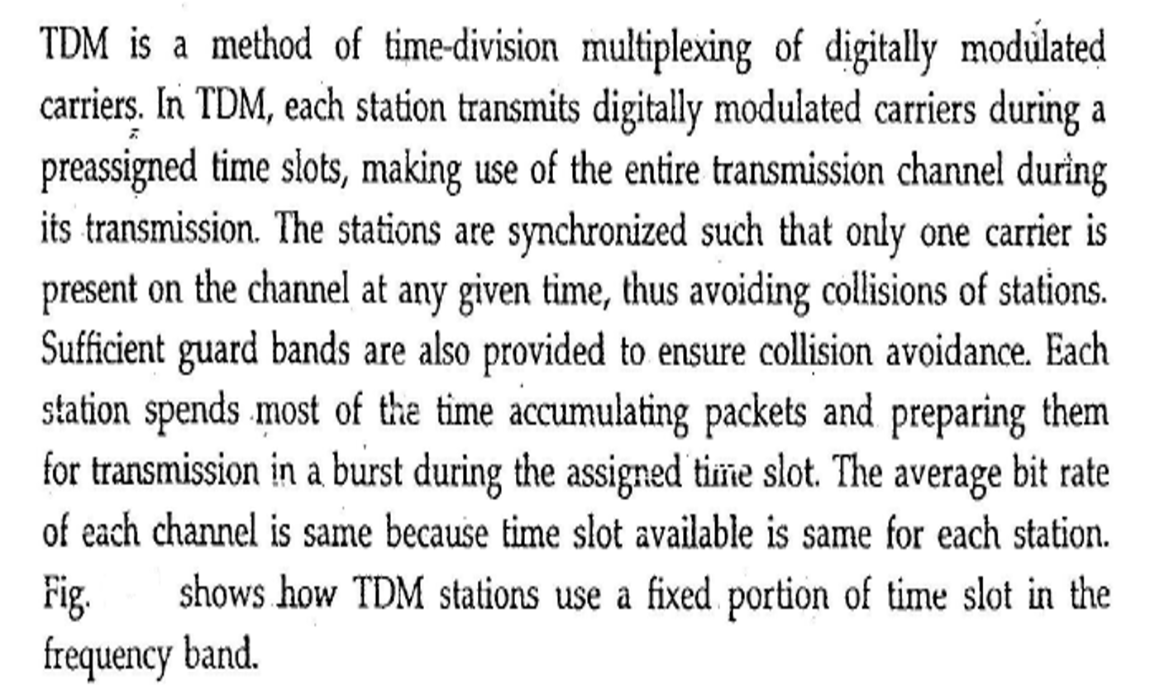
5-7: Time Division Multiplexing (TDM):

Slide 12
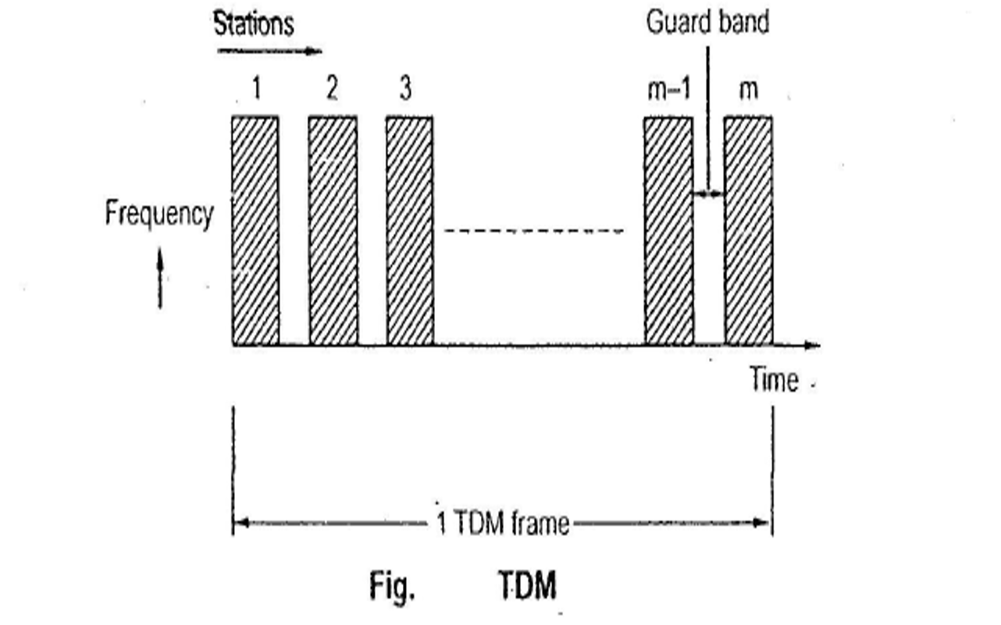

Slide 13
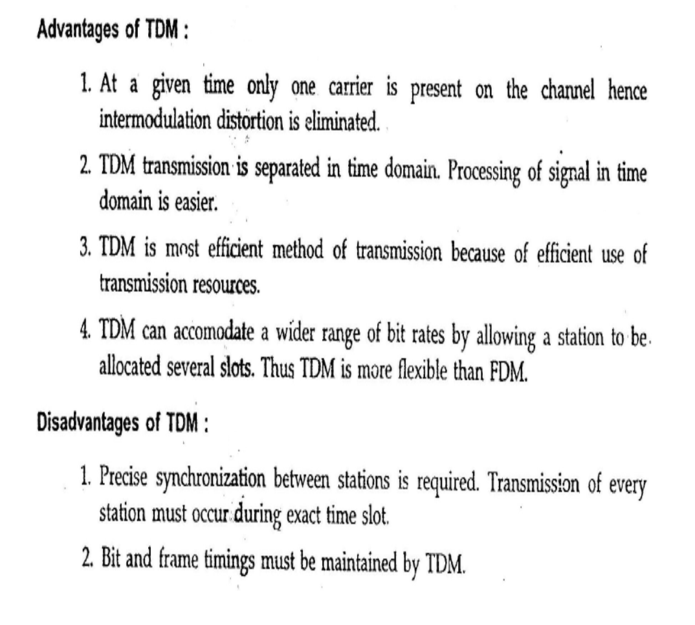
Advantages- disadvantages of TDM

Slide 14
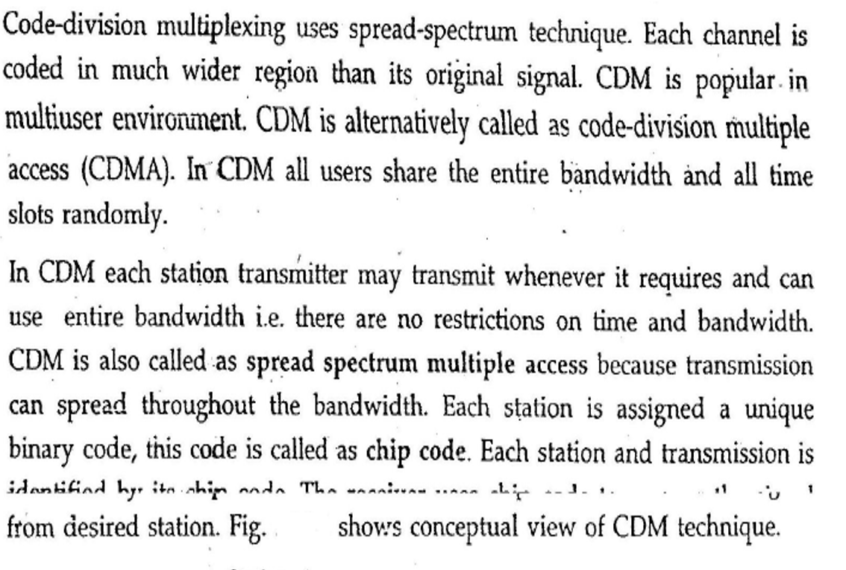
5-8: Code-Division Multiplexing (CDM)

Slide 15
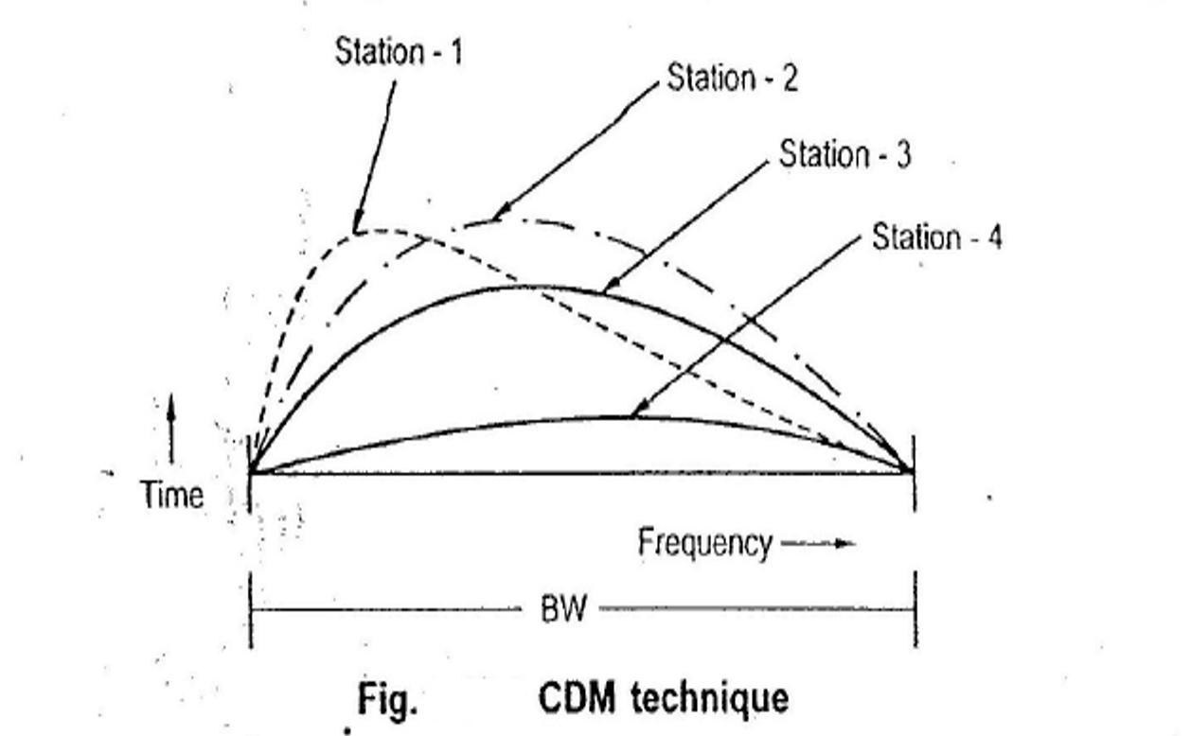

Slide 16
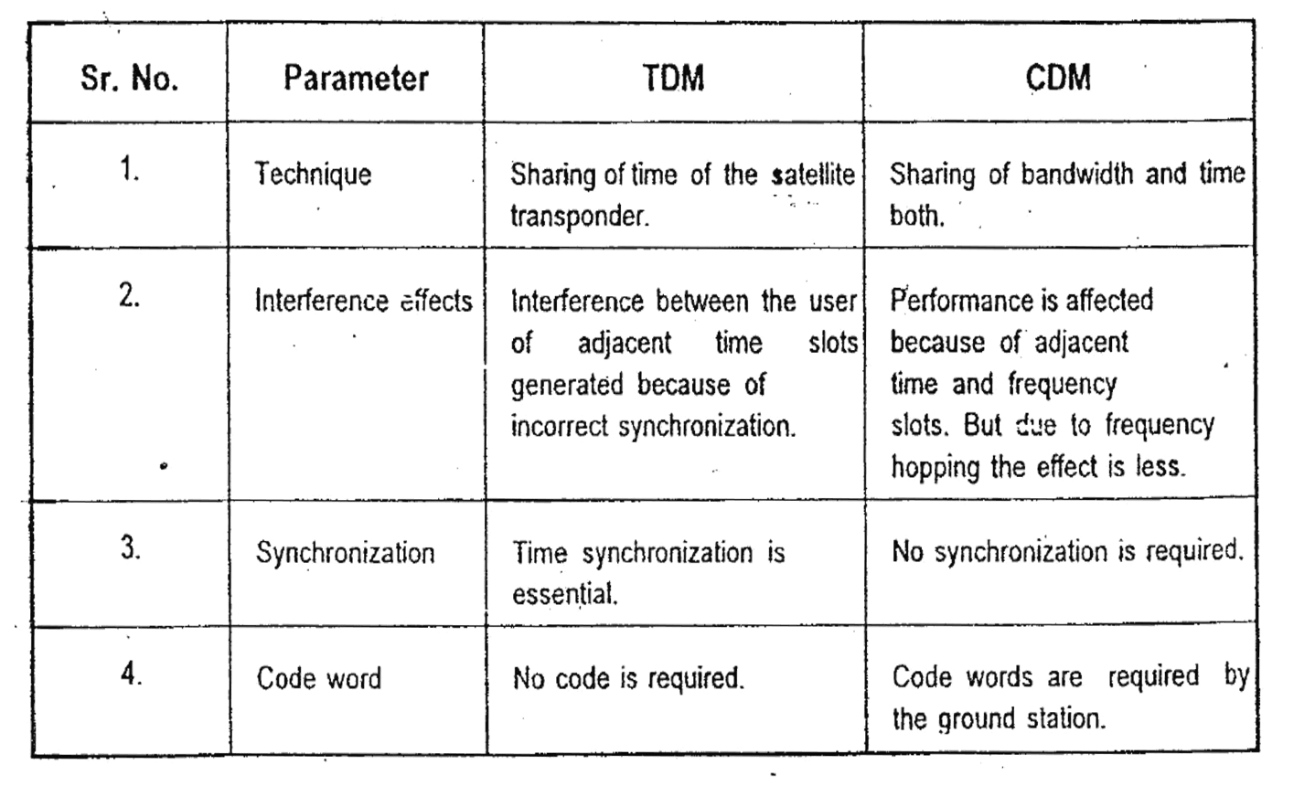
Table .(5-1). Comparison between TDM and CDM

