Slide 1
O F Link - power Budget

Slide 2
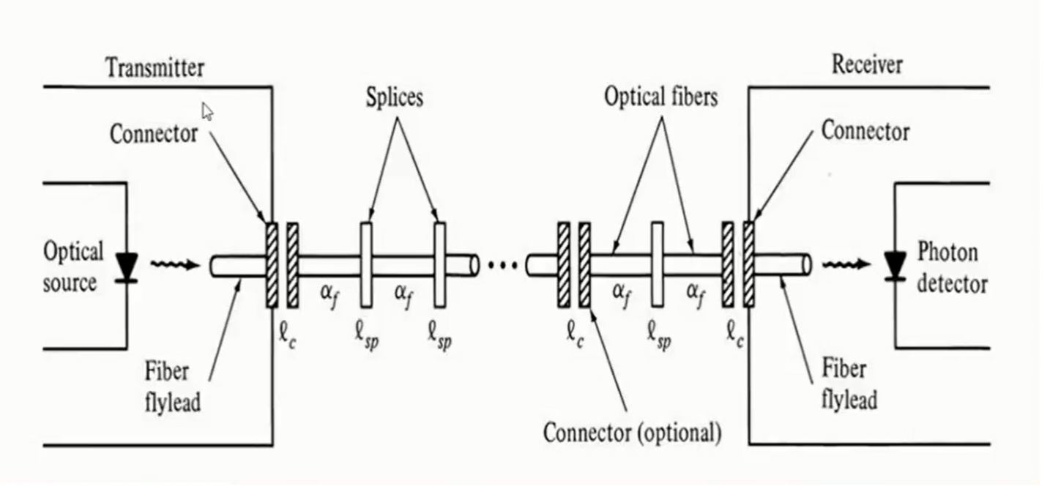
OF Link power Budget
For optimizing link power budget, an optical power loss Model is to be studied as shown

Slide 3
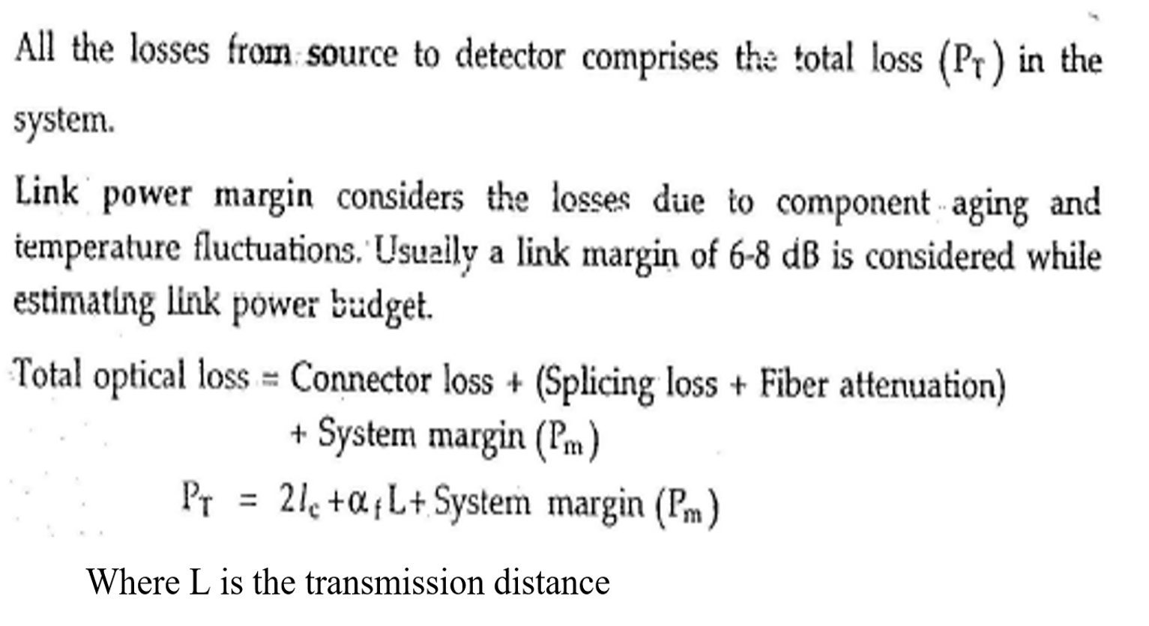
continue
Where:
lc is the losses occurs on connector
lsc is the losses occurs on splices
ᾲf is the losses through the OF cable

Slide 4
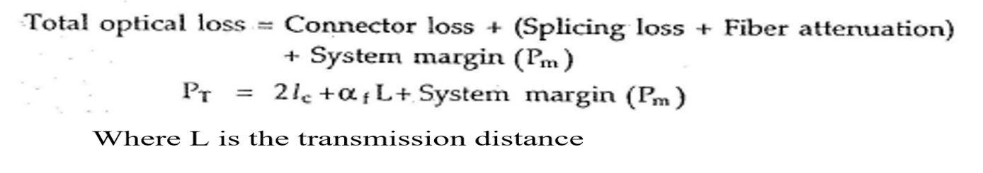
Power budget procedure
1. Calculating total actual optical link losses Pt by:
2. calculating allowable losses by:
Allowed losses = transmitted power – Sensitive power(received power)
3. If the total optical losses PT less than the allowed losses, the system function well
If Not the system function Bad

Slide 5
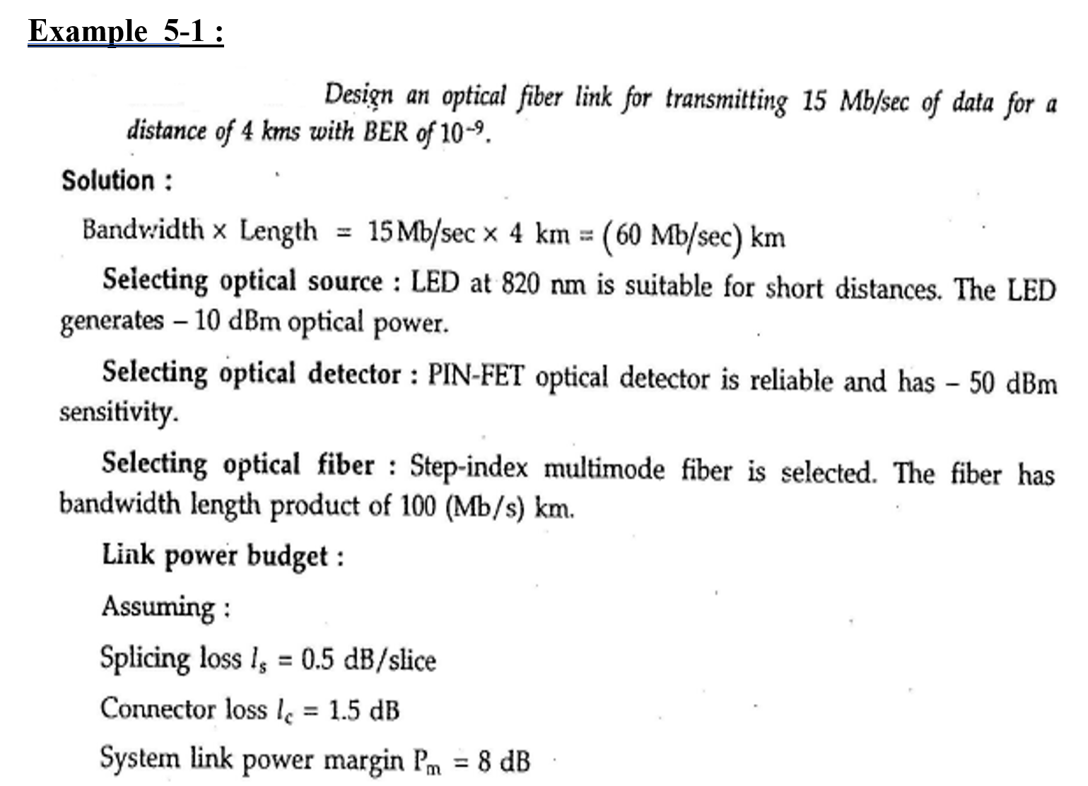
Examples

Slide 6
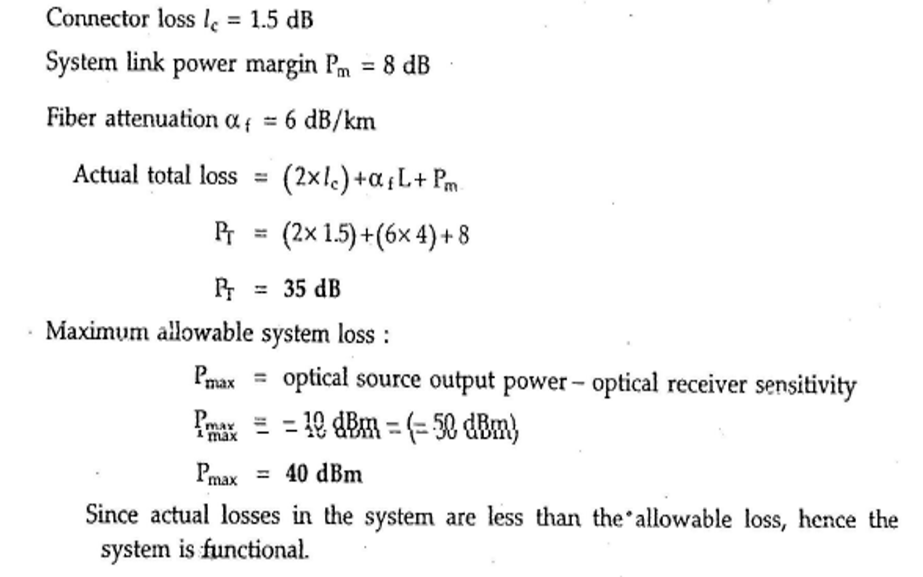
continue

Slide 7
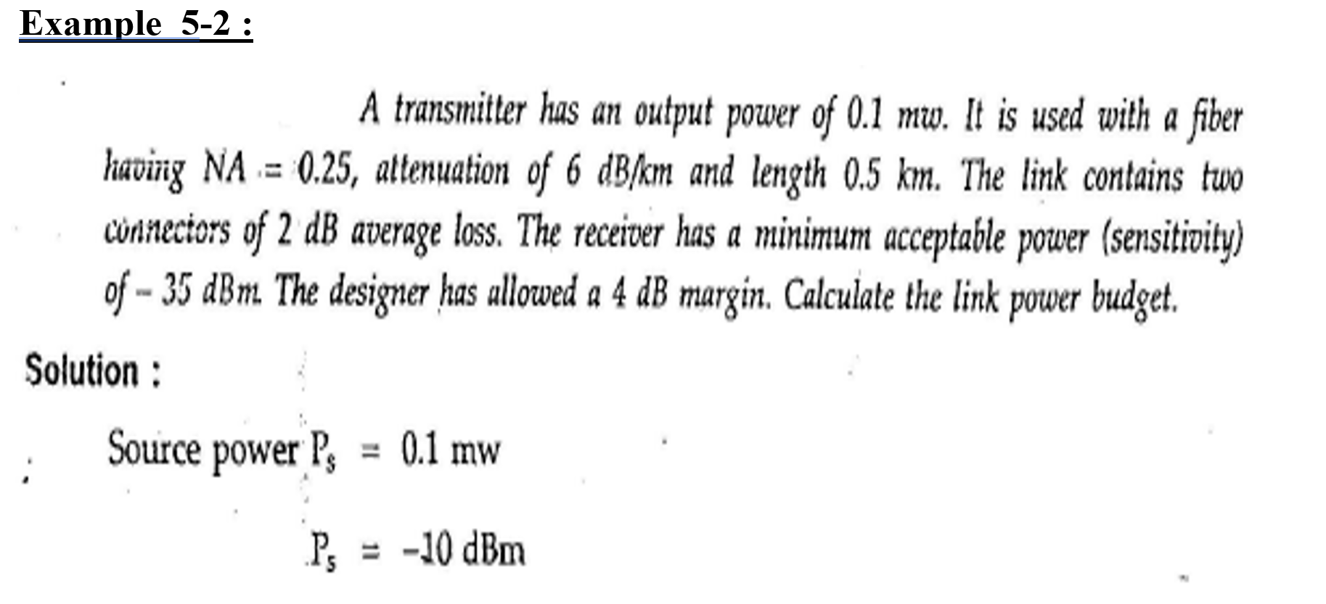

Slide 8
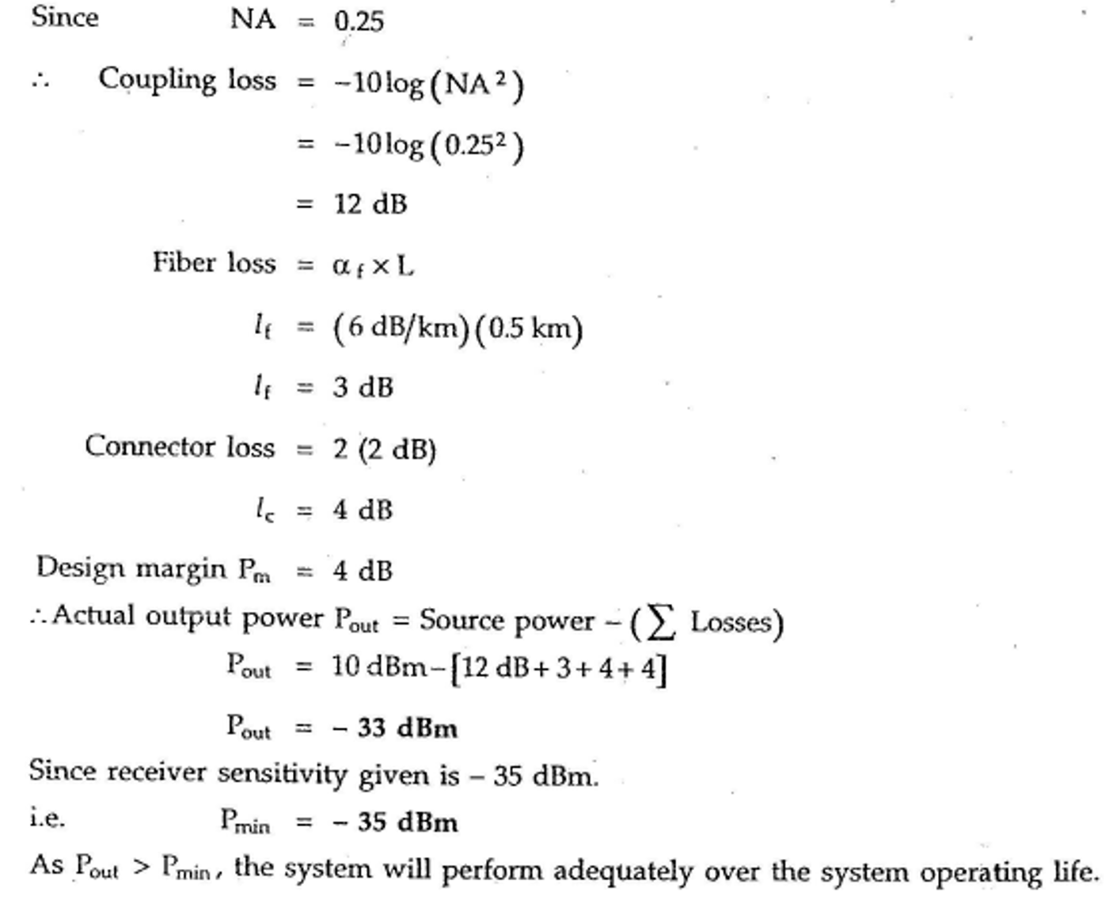

Slide 9
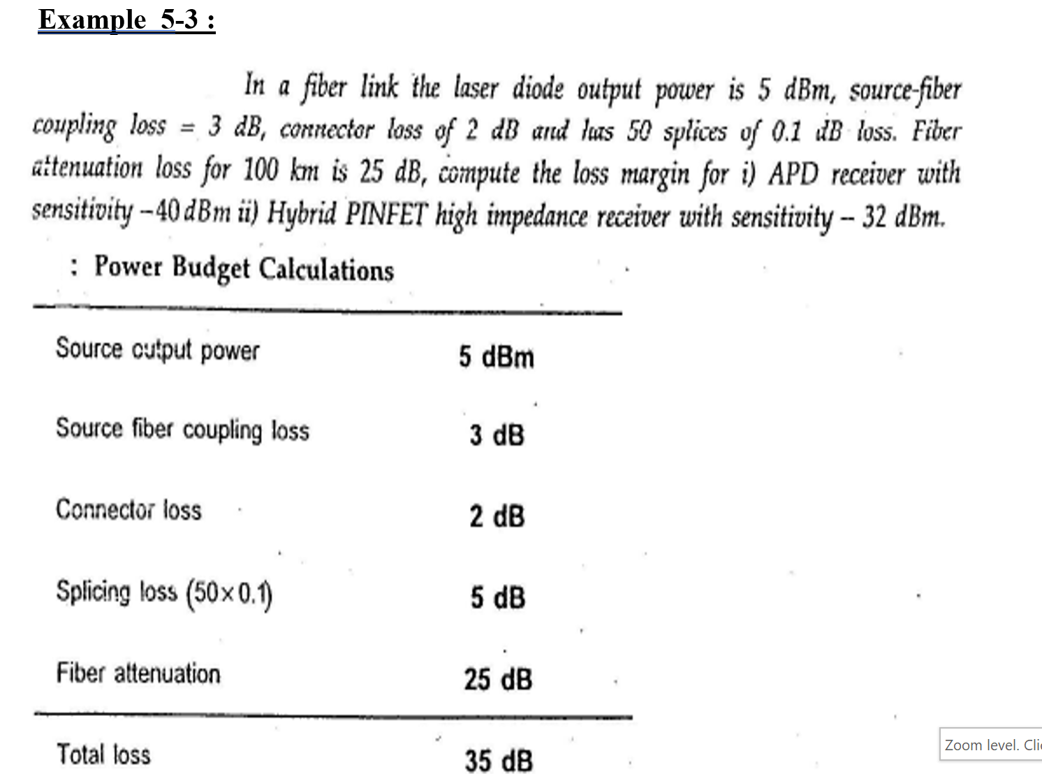

Slide 10
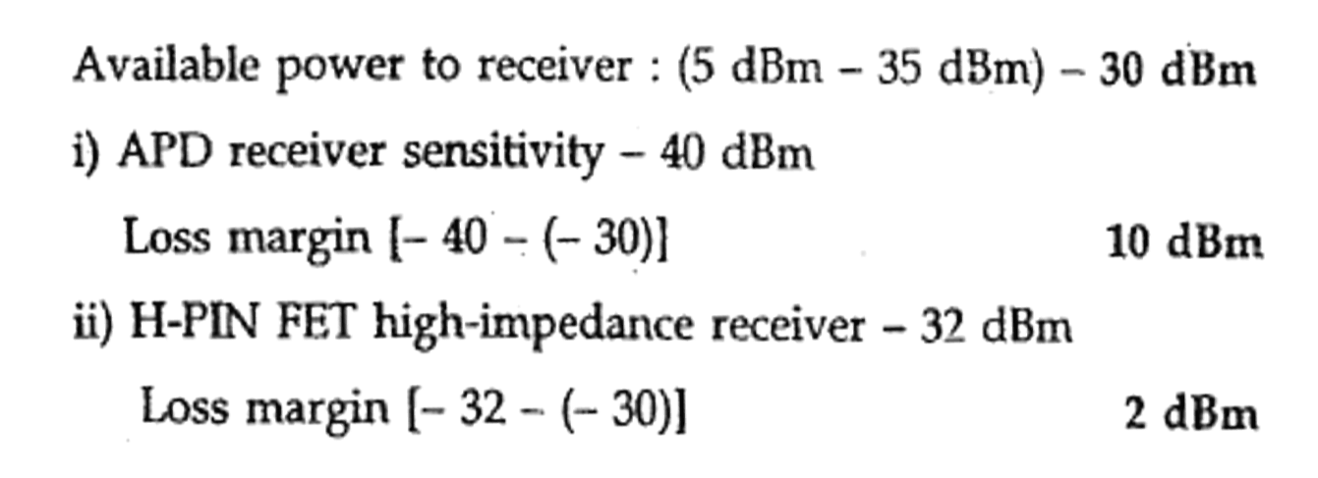

Slide 11
More examples
Optical communication – Examples-
Example 1
Optical transmitter has an O/P power of 0.1 mW, connected to an optical cable of 0.5 Km length.
The cable has following properties:
Attenuation factor = 6 dB / Km, NA =0.25,
it has two connectors of 2 dB per connector
The receiver has minimum acceptable power(sensitivity) of –35dBm
The allowed margin is 4 dB
Test for power budget of the system.

Slide 12
Continue
Solution:
Cable losses = 6 x 0.5 = 3 dB
Connector losses = 2x2 = 4 dB
Coupling losses = -10 Log (NA)² = - 10 Log(0.25 )² = 12 dB
Total actual losses = 3+4+12 +4 = 23 dB
Transmitted power in dB= 10 Log( 0.1 x10⁻³) =10 Log(10 ⁻⁴) = - 40 dB
The minimum received power is given = -35 dBm
Allowed losses = transmitted power – Sensitive power(received power)
Now we have some quantity in dB and other in dBm, to solve this problem, we have to be able to convert dB to dBm or vice versa

Slide 13
continue
dB = 10 Log (power in w)
dBm = 10 Log (power in mw) =
= 10 log (power Pw x1000) = 10 log(Pw) +10 log 1000
dBm = dB + 30 and
dB = dBm -30
Then minimum received (sensitive ) power in dB
= - 35 dBm – 30 = - 65 dB
Allowed losses = -40 – (-65) = 25 dB
Since actual losses is less than allowed one, the system
is running O.K.

Slide 14

Example

Slide 15
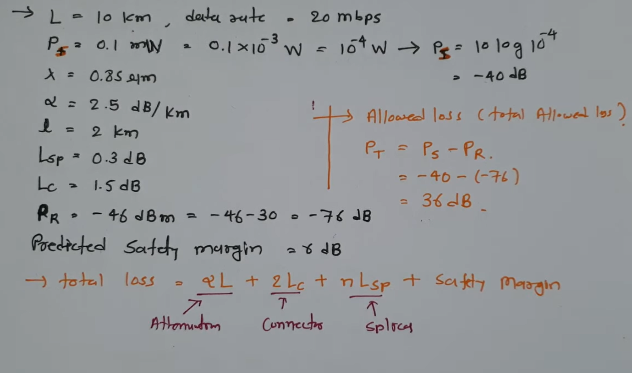
solution

Slide 16
