Slide 1
Optical sources
introduction

Slide 2
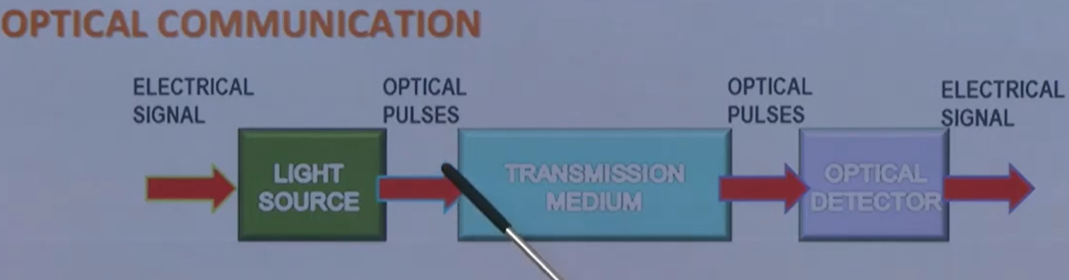
Introduction
In the next few lectures, we would look into other segments of optical communication system.
They are, Optical Source (Light source )on the transmitter side and Optical Detector in receiving side.

Slide 3
continue
If we have such optical fiber(OF) communication system, we have Electric signal, which modulate the light source.
This electric signal contains the data. so, it has got electric pulse train.
The electric pulse train modulates the light source and generates optical pulses.
These optical pulses are sent through the transmitting medium which is optical fiber cable.
And the optical pulses after travelling the OF, now they received at Optical detector, are converted back into electric pulses.

Slide 4
Light sources
For the optical sources, what are the requirements?
Optical communication is primarily done at 2 wavelengths, 1300 nm, which is zero dispersion wavelength and 1500 nm which is minimum attenuation wavelength.
Then the optical sources should give a light pulse train in one of these WL.
These sources should be able to get modulated at speeds in excess of several Gbps, and also With all these qualities,
the source should be efficient and compact, reliable, should be not malfunction during the process.
Should be durable and not expensive.

Slide 5
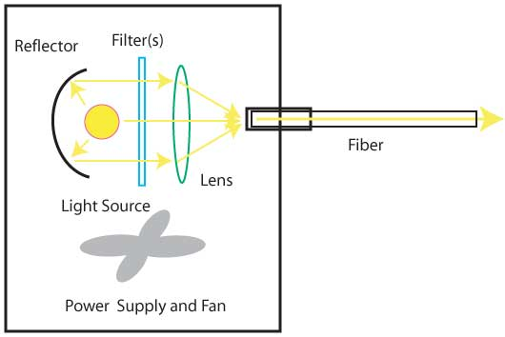
Optical source

Slide 6
How do, They make these sources?
These sources are primarily based on Semiconductor optical materials.
Semiconductor materials and 2 primarily sources are:
- Light Emitting Diode (LED) and
- Laser Diode (LD)

Slide 7
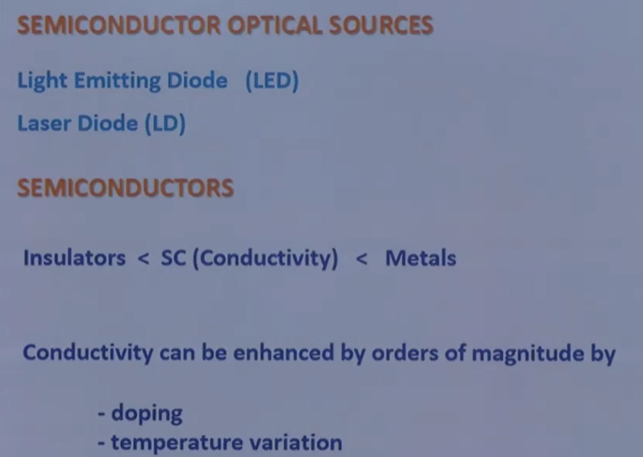

Slide 8
Light Emitting Diode(LED) :
In any optical communication system when the requirement are: -
- Bit rate of 100-200 Mb/sec.
- Optical power in tens of microwatts.
LEDs are best suitable optical source.

Slide 9
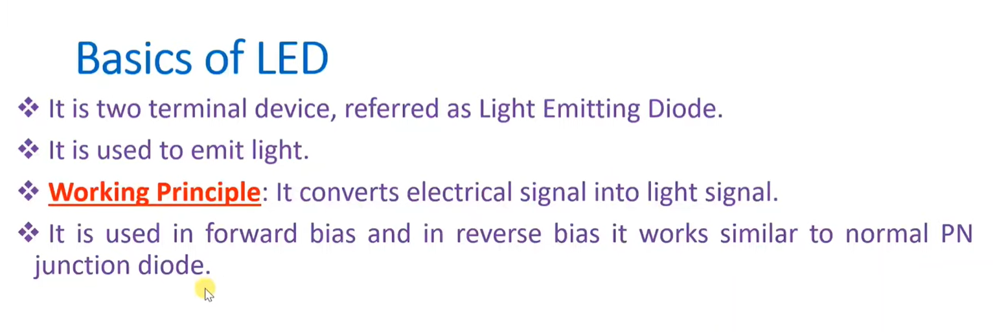
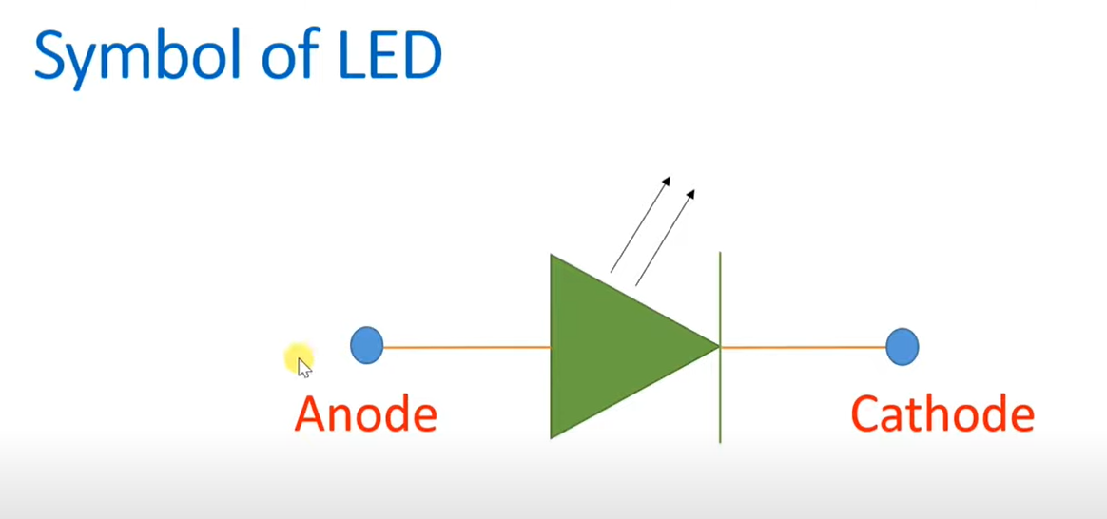
Basic of LED and its Symbol

Slide 10
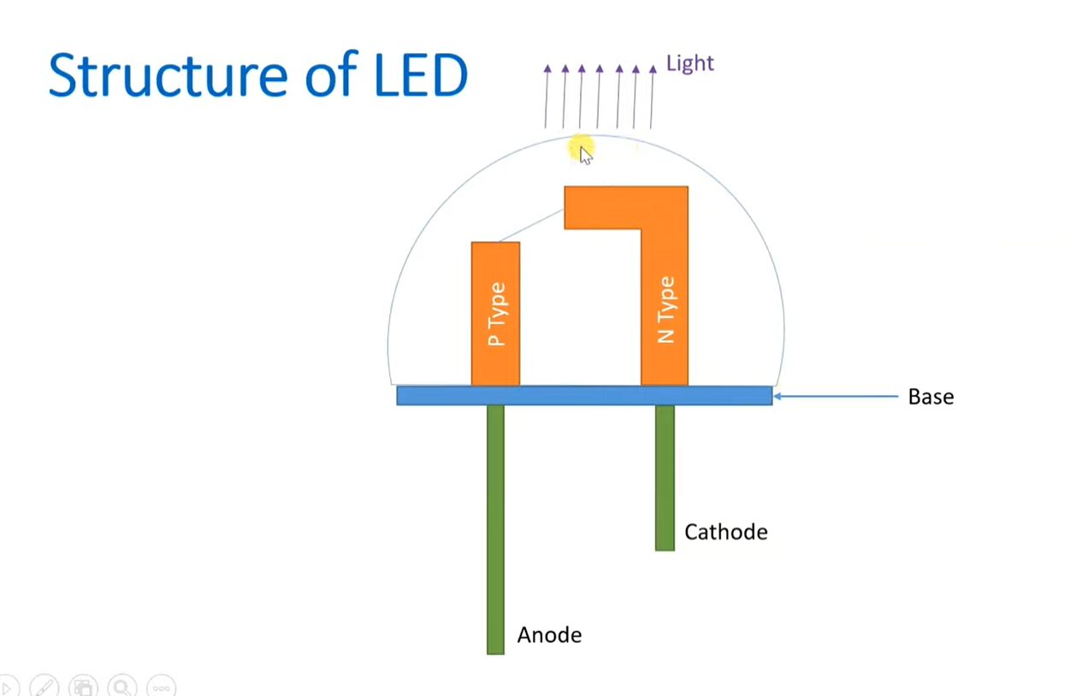
Structure of LED

Slide 11
continue
The anode is connected to P type and cathode is connected to N type.
If this diode is forward biased there will be a light generated between
P and N ends.
If the LED is covered by transparent cup, the light will see from the external.

Slide 12
Continue
Since there are holes and electrons in the junction layer, these will be compinged process and leave a two barrier of Electron and Holes in this area
These two barrier form a Potential barrier which does not allow more current to pass from P-type material to N-type material.
When a forward potential applied across the diode more than the potential barrier, a current will flow from P-type to N-type.

Slide 13
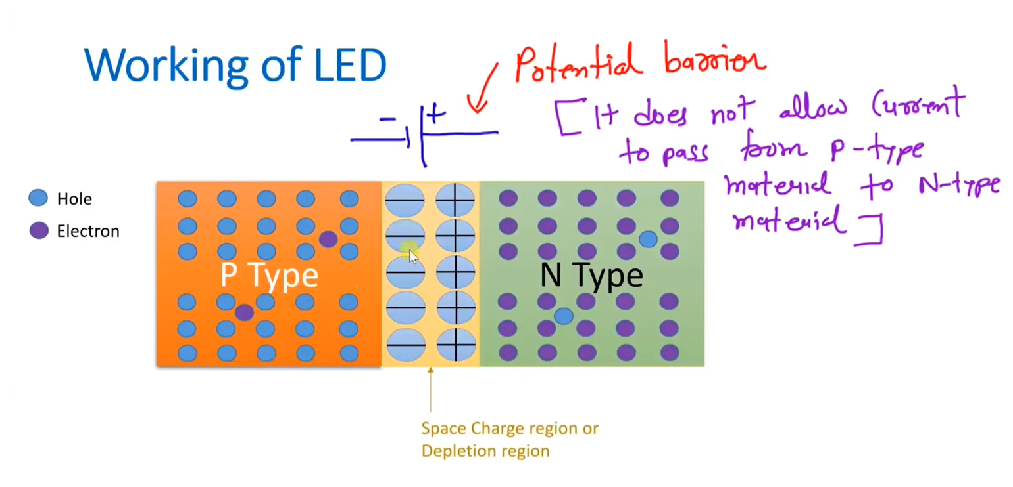
Working of LED

Slide 14
Working of LED
The P-N junction contain positive free charge (holes) in P – type and Negative free charge in(electrons) N- type.
These free charge are in balance after the making of potential barrier.
When the LED is Forword biased (P connected to Positive and N to negative terminals) with a potential greater than potential barrier, the holes moves from P-Type to N-type and N-type moves from N to P –type.

Slide 15
Continue
The free charges(before biasing) are in Conduction Energy Band
When they are jumping, they becomes in Valance Energy Band
The jumped charge are combined in both P and N rejoins and released a light.
The light energy comes from released energy(Eg) results as jumping happens from high level energy (conduction band) to low level energy(valance band)

Slide 16
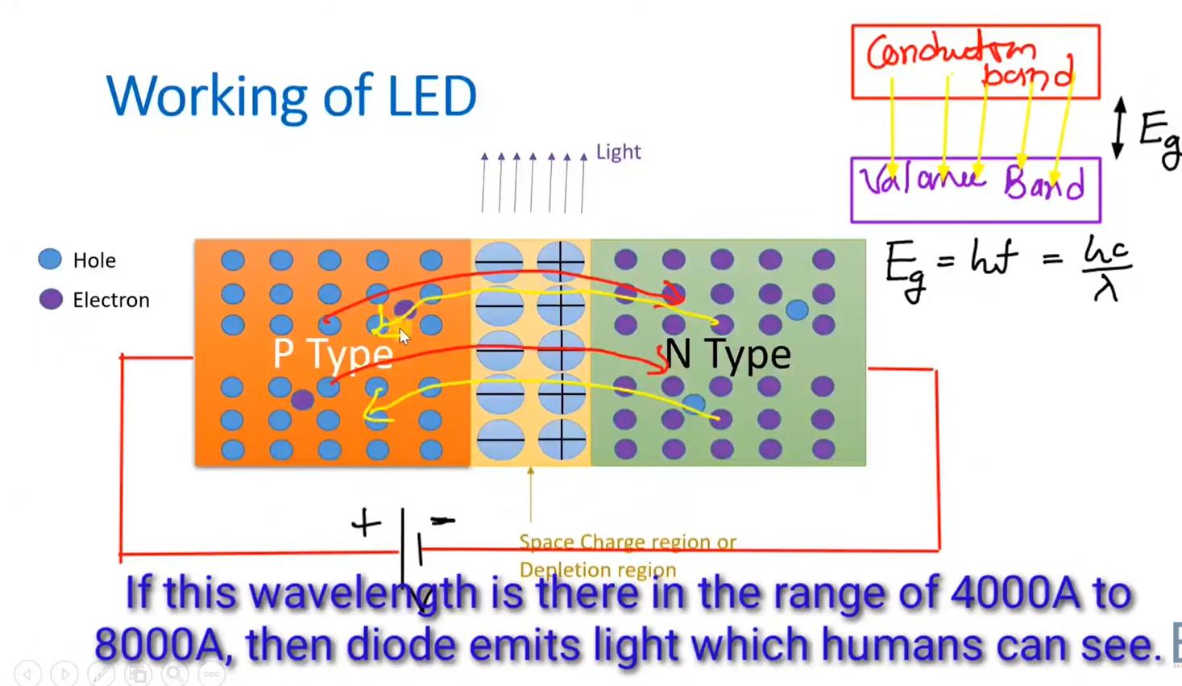
Working of LED
The angstrom, also known as the angstrom unit, is a measure of displacement equal to 0.0000000001 meter (10 ⁻¹⁰ m). It is sometimes used to express wavelength s of visible light, ultraviolet (UV) light, X rays, and gamma rays.

Slide 17
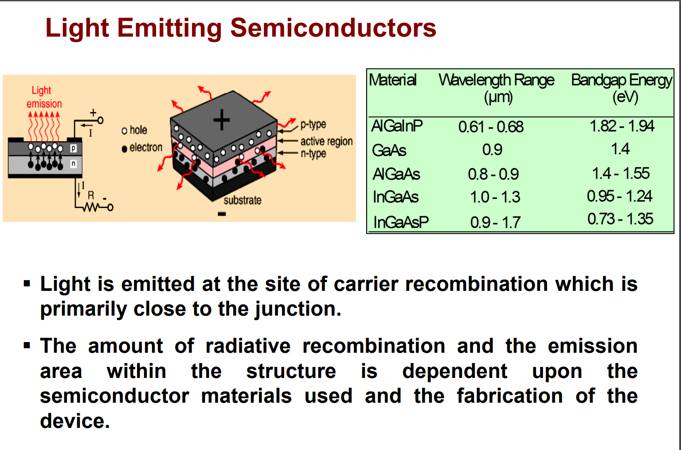
continue

Slide 18
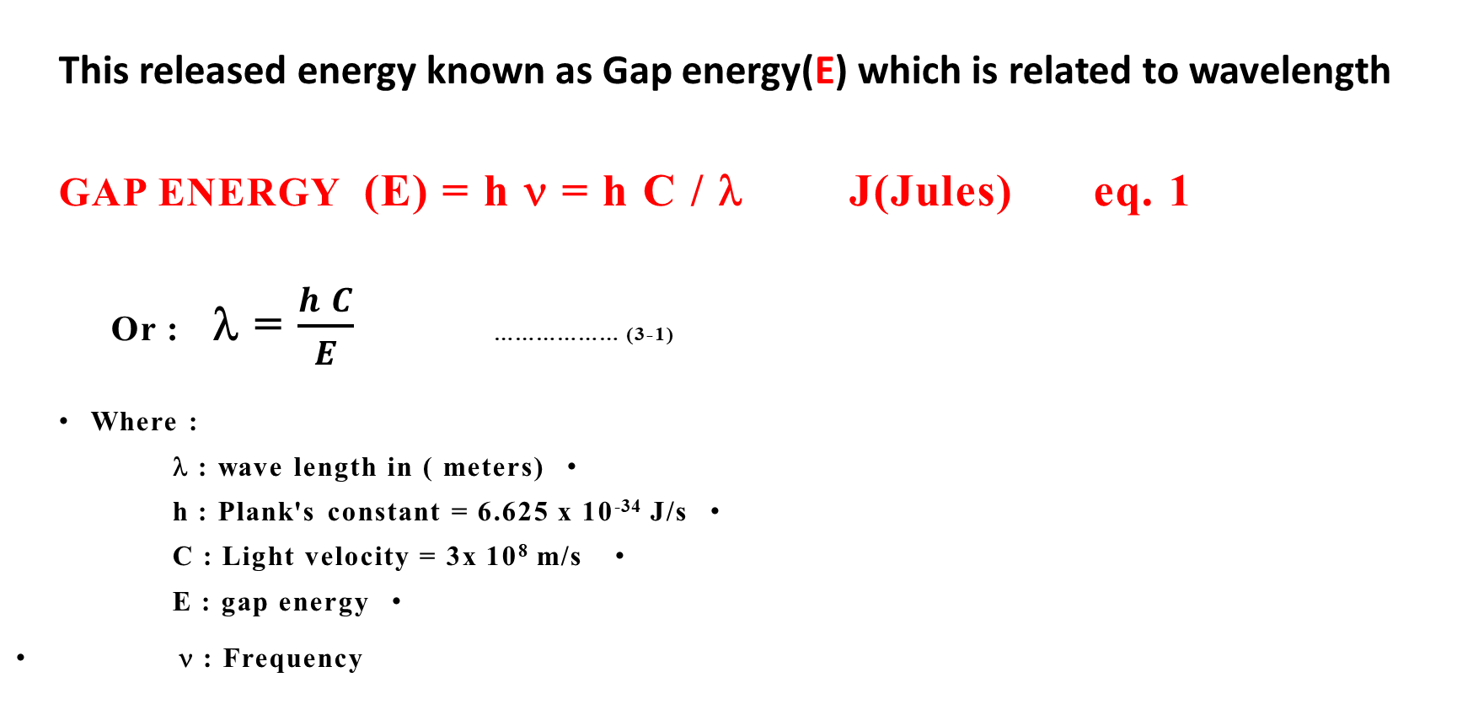
LED Equations
This released energy known as Gap energy(E) which is related to wavelength
GAP ENERGY (E) = h ν = h C / λ J(Jules) eq. 1
Or : λ = $\frac{h C}{E}$ ……………… (3-1)
Where :
λ : wave length in ( meters)
h : Plank's constant = 6.625 x 10⁻³⁴ J/s
C : Light velocity = 3x 10⁸ m/s
E : gap energy
ν : Frequency

Slide 19
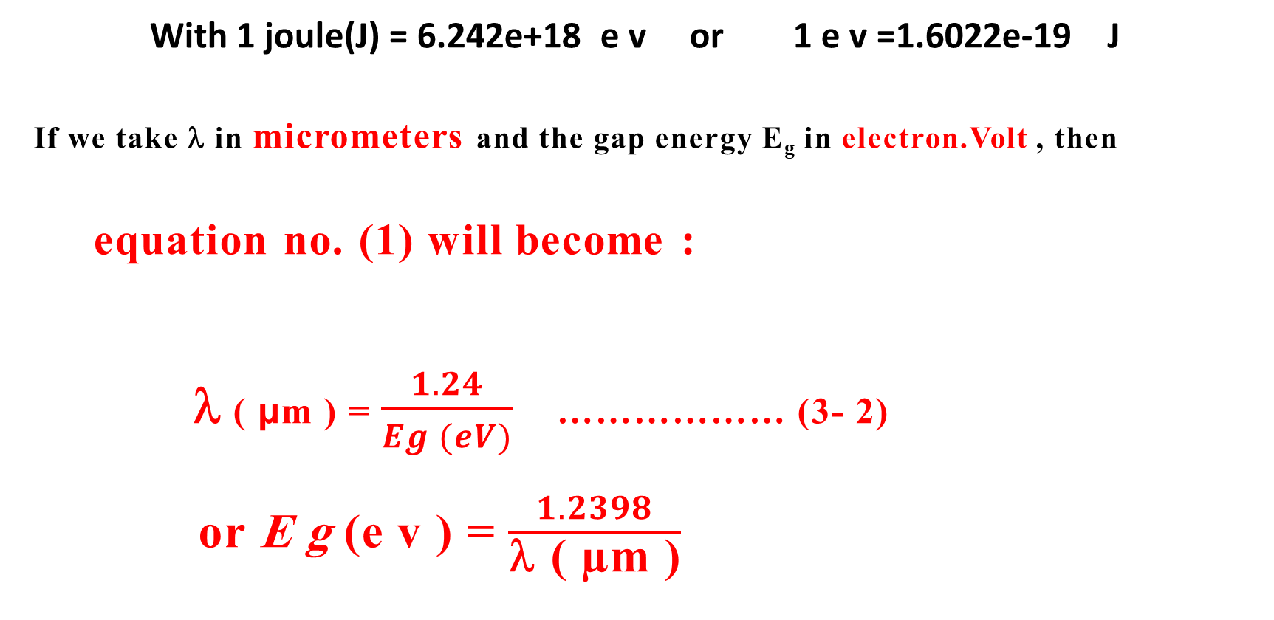
continue
With 1 joule(J) = 6.242e+18 e v or 1 e v =1.6022e-19 J
If we take λ in micrometers and the gap energy E_{g} in electron.Volt , then
equation no. (1) will become :
λ ( µm ) = $\frac{1.24}{Eg (eV)}$ ……………… (3- 2)
or E g (e v ) = $\frac{1.2398}{\text{λ}\text{ ( µ}\text{m} \text{)}}$

Slide 20
Continue
We can think of radiation either as waves or as individual particles called photons.
The Energy associated with a single photon is given by E = h ν ,
where E is the energy (SI units is J), h is Planck's constant (h = 6.626 x 10–34 J s), and ν is the frequency of the radiation (SI units is s–1 or Hertz, Hz) .
Frequency is related to wavelength by λ=c/ν , where c, the speed of light, is
3 x 108 m s–1.
Another quantity that you will often see is wavenumber, σ=1/λ, which is commonly reported in units of cm–1.

Slide 21
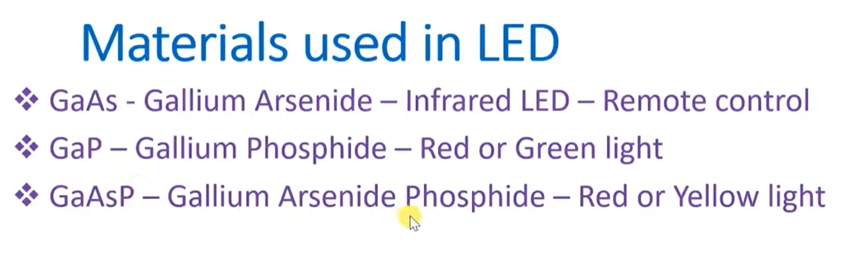
Material s used in LED

Slide 22
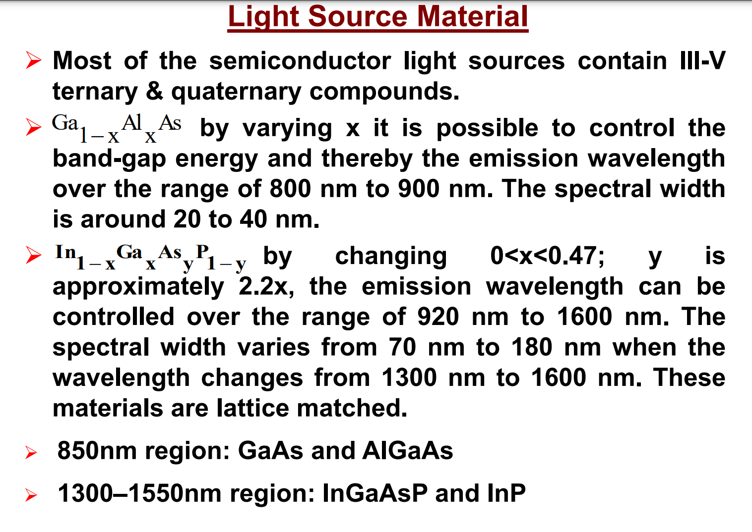
Continue

Slide 23
continue
The LED materials are compounds of group III element (such as : Al , Ga , In) and group V ( such as : P , As , Sb )
Some tertiary alloys such as ( Ga_{1-x} Al_{x} As ) and
quaternary alloys such as ( In_{1-x} Ga_{x} As_{y} P_{1-y} ) are also used.

Slide 24
continue
Different materials and alloys have different band gap Energies, which can be controlled by two compositional parameters: x and y.
For example : the quaternary alloy : ( In_{1-x} Ga_{x} As_{y} P_{1-y} ) is the principal material used in LED.
Two expressions are used :
E_{g} = 1.424 + 1.266 x + 0.266 x² ………………… (3-3)
E_{g} = 1.35 – 0.72 y + 0.12 y² ………………… (3-4)

Slide 25
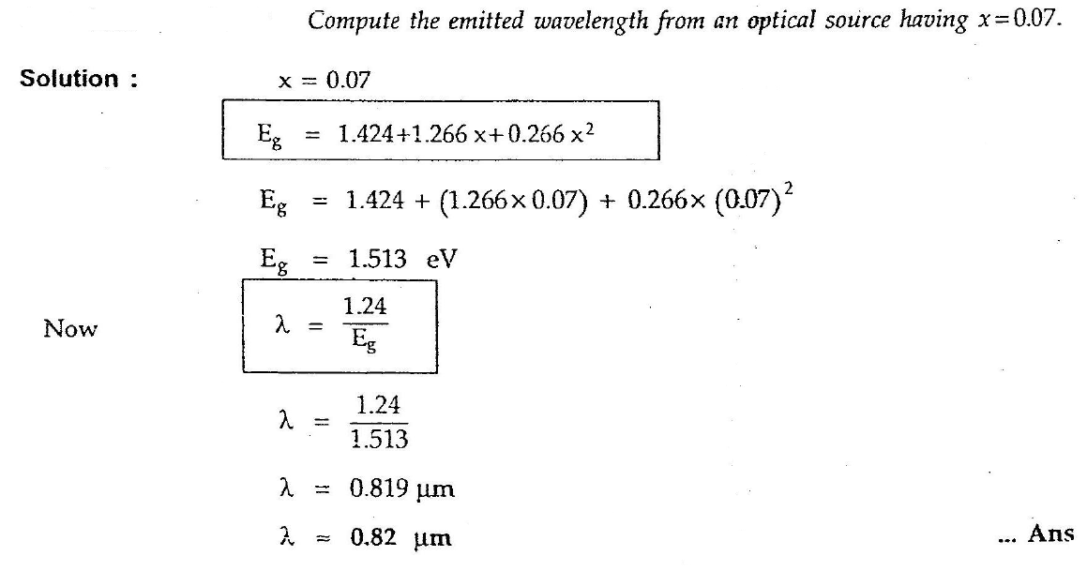
Examples - example -1

Slide 26
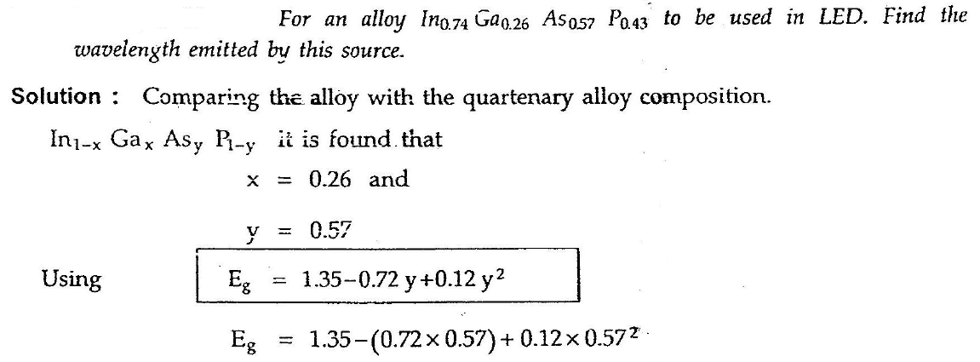
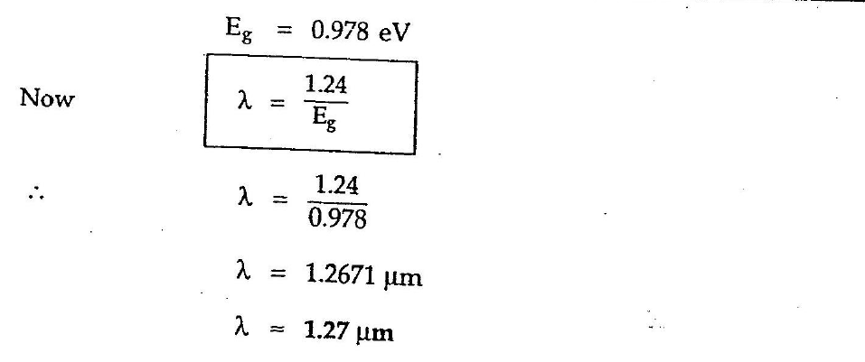
Example 2

Slide 27
LED configuration
At present there are two main configuration types of LED used in optical fiber links -
1. Surface Emitting LED.
2. Edge Emitting LED.
Both devices use a DH structure to constrain the carriers and the light to an active layer.

Slide 28
1. Surface Emitting LED
In this LED type, optical fiber is butt-coupled with itself. This is shown in the figure-1.
• The surface Emitting LED structure consists of thin central active layer of P type GaAs.
• This central layer is bounded by N-type
Al Ga As /n⁺-type GaAs at the top side.
• This central layer is bounded by P-type
Al Ga As/p⁺-type GaAs at the bottom side.
• The extreme top N⁺ type GaAs and bottom P⁺-type GaAs layers are used to provide low resistive ohmic contacts only.

Slide 29
CONTINUE
The external optical fiber is butt connected by etching the top layers and by shielding with epoxy resin.
• When refractive indices of both p-type and n-type materials are same, light is free to come out from all the sides of the semiconductor device due to no confinement.
However, only active region near the surface will emit the significant amount of light while absorbing from the other parts. Hence it is known as surface emitting LED.

Slide 30
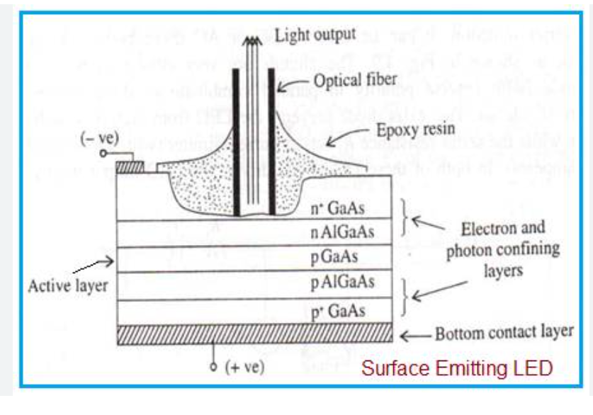
Surface Emitting LED – construction Fig. 1

Slide 31
2. Edge Emitting LED
In this type of configuration,
Central active layer is made using InGaAs having narrow bandgap. It is bounded by wide bandgap layers such as
P+ InGaAsP and N+ InGaAsP cladding layers
.
• These two cladding layers help in confining injected electrons and holes into the middle layer. It also helps emitted photons to travel along LED axis as per optical properties.
• Due to above, light is emitted from the edge of the LED. Hence it is known by the name Edge Emitting LED.

Slide 32
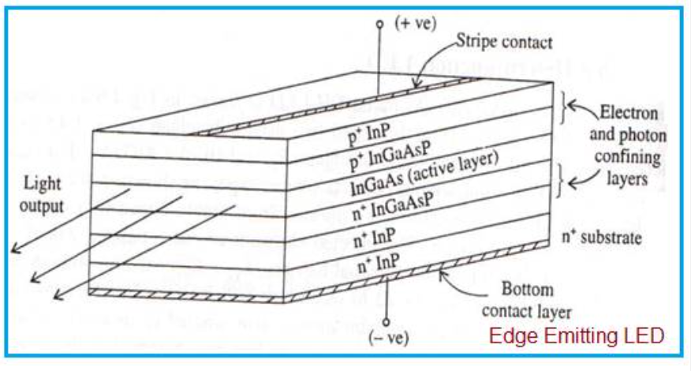
Edge Emitting LED - construction

Slide 33
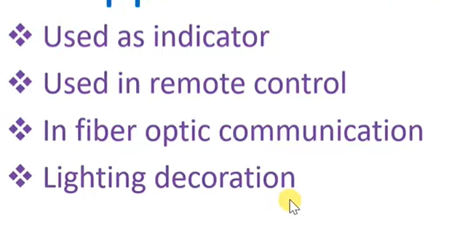
Applications of LED

